Slide 1
DATA ENGINEERING 1
INTRO
Laszlo Sallo
SEPTEMBER 2024

Slide 2
WHO DO YOU WANT BE (OR NOT TO BE)?

Slide 3
THE DATA SCIENTIST
STATISTICIAN
DATA MINER
PREDICTIVE ANALYST
BUSINESS
ANALYST
DATA SCIENTIST
(ENTERPRISE)
DATA ANALYST
BUSINESS
SCIENCE

Slide 4
COURSE SUMMARY – PART1
MANIPULATING DATABASE
WITH SQL USING MYSQL AS
RELATIONAL DATABASE MANAGEMENT SYSTEM

Slide 5
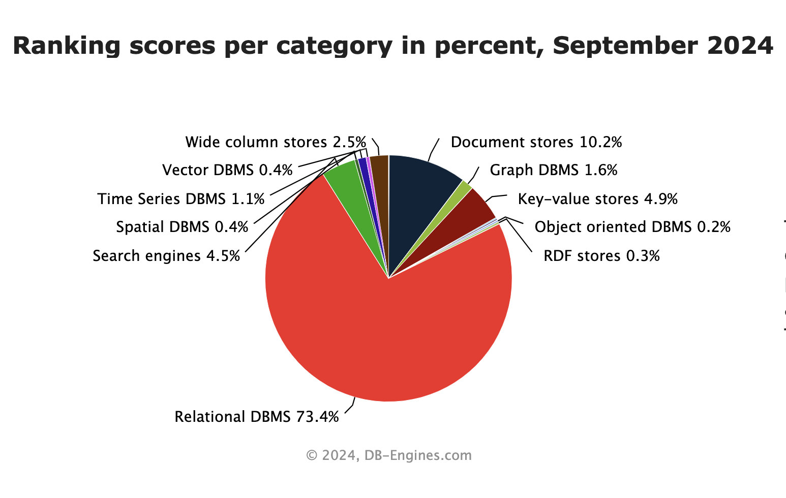
WHY?

Slide 6
SQL IN 5 MINUTES
IN A CHROME BROWSER
GOOGLE
The Try-SQL Editor

Slide 7
BOOKS & OTHER MATERIALS
https://www.w3schools.com/sql/sql_intro.asp
https://dev.mysql.com/doc/refman/8.0/en/
https://www.mysqltutorial.org/

Slide 8
COURSE KNOWLEDGE BASE
CEU Moodle
GIT
https://ceulearning.ceu.edu
https://ceu-economics-and-business.github.io/ECBS-5146-Different-Shapes-of-Data/

Slide 9
ENVIRONMENT TO SETUP
+

Slide 10
EVALUATION AND EXPECTATIONS
Course participation (10%)
Term Project 1 (30%)
Term Project 2 (40%)
Final Quiz (20%)
Intellectual contribution aka BE PRESENT
HELP each other
Do not DESPAIR, ask for help
DO the extra mile

Slide 11
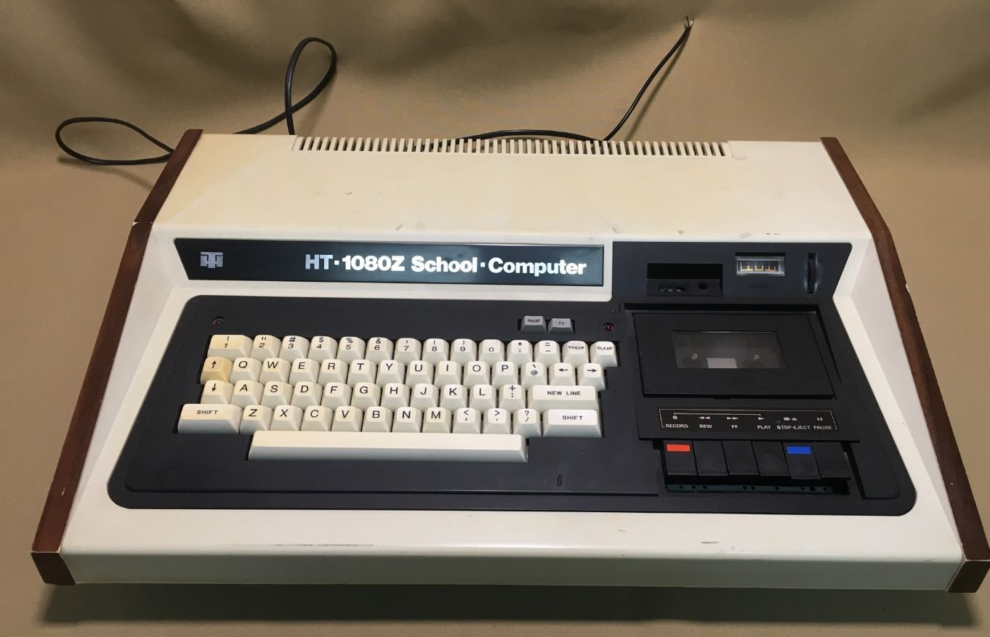
ABOUT US
LASZLO SALLO
LinkedIn: https://www.linkedin.com/in/laszlosallo
Mail: sallol@ceu.edu

Slide 12
ABOUT US
SANDOR BUDAI
LinkedIn: https://www.linkedin.com/in/sandor-budai/
Mail: sbudaiga@gmail.com

Slide 13
STUDENT SUPPORT
You can reach us on: Email or MS Teams
Classwork: Microsoft Teams Channel
Tutoring: On demand, afternoons on MS Teams
Notes:
Data Engineering 1: SQL and Different Shapes of Data | 2024 DE1 Sessions | Microsoft Teams

Slide 14
PRESSING QUESTIONS OF CHAPTER 1
What is SQL?
What is a Relational Model?
What is a Relational Database?
What is RDBMS?
What is MySQL?
Difference between MySQL and other RDBMS?

Slide 15
THE HISTORY OF DIGITAL PERSISTENCY

Slide 16
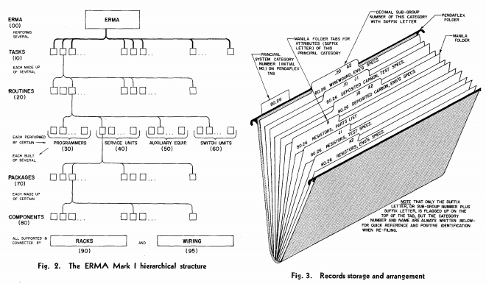
50’s FILE SYSTEM ROCKS!

Slide 17
60’s DATABASE FOR PEOPLE
Database Management Systems:
Simultaneous access to data
Security / User management
Administration
Unified access interface

Slide 18
TABULAR
TABLE
COLUMN or FIELD
HR_EVENTS
ID | DATE | NAME | EMAIL | OPERATION | TITLE | TITLE_REFID
1 | 2015.05.09 | John | john@company.com | join | Junior Analyst | 34
2 | 2017.05.10 | Kate | kate@company.com | promotion | Senior Analyst | 67
3 | 2017.05.10 | John | john@company.com | departure | Senior Analyst | 67
4 | 2017.05.11 | Mary | mary@company. com | join | Lead Analyst | 23
ROW or RECORD

Slide 19
RELATIONAL
EVENT
PRIMARY KEY
ID | DATE | EMPLOYEE_ID | OPERATION | TITLE_ID
1 | 2017.05.09 | 1 | join | 3
2 | 2017.05.10 | 2 | promotion | 2
3 | 2017.05.10 | 1 | departure | 2
4 | 2017.05.11 | 4 | join | 1
EMPLOYEE
ID | NAME | EMAIL
1 | John | john@company.com
2 | Kate | kate@company.com
4 | Mary | mary@company.com
FOREIGN KEY
TITLE
ID | TITLE | TITLE_REFID
1 | Lead Analyst | 23
2 | Senior Analyst | 67
3 | Junior Analyst | 34

Slide 20
DATABASE NORMALIZATION
The process of organizing the columns and tables of a database to reduce data redundancy and improve data integrity.

Slide 21
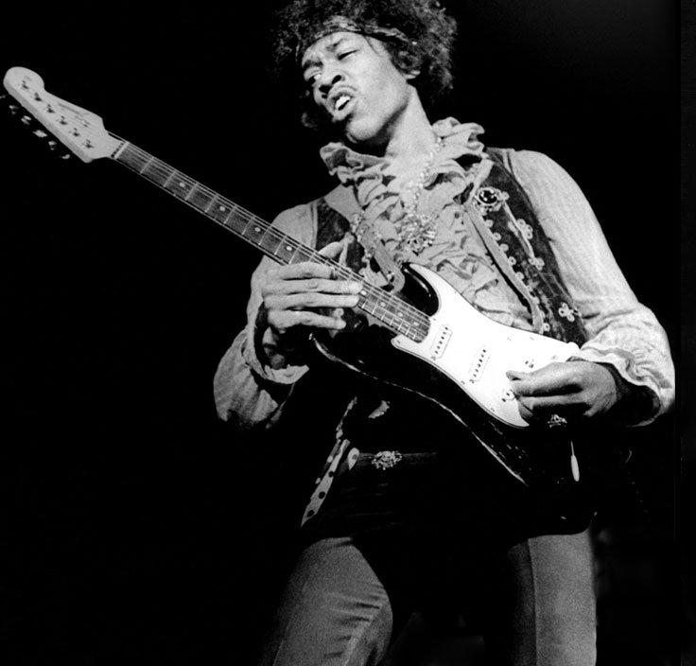
70’s HIT: THE RDBMS
Relational Database Management System
A digital database using the relational model of data for storing data

Slide 22
80’s DISCO: SQL RDBMS
Structured Query Language
is a language
designed to interact (“talk”) with a database.
“Find all customers”
“Add a new product”
“Delete orders”
Standardized but multiple dialects.
Once you learn on dialect,
you can easily switch to another

Slide 23
SQL EXAMPLE
EVENT
ID | DATE | EMPLOYEE_ID | OPERATION | TITLE_ID
1 | 2017.05.09 | 1 | join | 3
2 | 2017.05.10 | 2 | promotion | 2
3 | 2017.05.10 | 3 | departure | 2
4 | 2017.05.11 | 4 | join | 1
SELECT TITLE_ID FROM EVENT WHERE ID=3
TITLE_ID
2

Slide 24
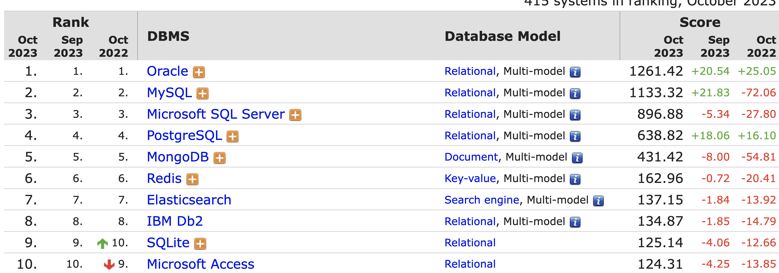
SQL MONOPOLY 1980-2010

Slide 25
MYSQL VS …
Available for free
Most widespread RDBMS
Does not strives to be 100% standard SQL compliant
Less strong in enterprise features, yet not lightweight
MORE:
https://www.keycdn.com/blog/popular-databases

