Slide 1
DATA ENGINEERING 1
DATA MODELING AND JOINS
Laszlo Sallo
SEPTEMBER 2024

Slide 2
DATA MODELING - RELATIONSHIPS

Slide 3
ONE-TO-ONE (1:1) RELATIONSHIP

Slide 4
ONE-TO-MANY (1:N) RELATIONSHIP
PAGE_ID | PAGE | BOOK_ID | PAGE_CONTENT
1 | 1 | 1 | This is the kind of foresight …
2 | 2 | 1 | The art of constructing a…
3 | 1 | 2 | Great times call for great men …
4 | 1 | 3 | “Bill Palmer here” I say ..
BOOK_ID | BOOK_TITLE
1 | Accelerate
2 | Švejk
3 | Phoenix Project

Slide 5
MANY-TO-MANY (M:N) RELATIONSHIP

Slide 6
MANY-TO-MANY (M:N) RELATIONSHIP
Authors
Books
Authors
Books
AUTHORS
AUTHORS_BOOKS
BOOKS
AUTHOR_ID | AUTHOR_NAME
1 | Gene Kim
2 | Nicole Forsgren
3 | Jaroslav Hašek
4 | Jez Humble
AUTHOR_ID_FK | BOOK_ID_FK
1 | 1
1 | 3
2 | 1
4 | 1
3 | 2
BOOK_ID | BOOK_TITLE
1 | Accelerate
2 | Švejk
3 | Phoenix Project

Slide 7
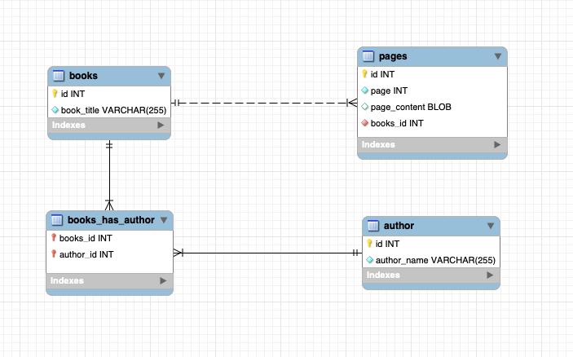
DATA MODELING IN MYSQL WORKBENCH

Slide 8
DATA JOINING

Slide 9
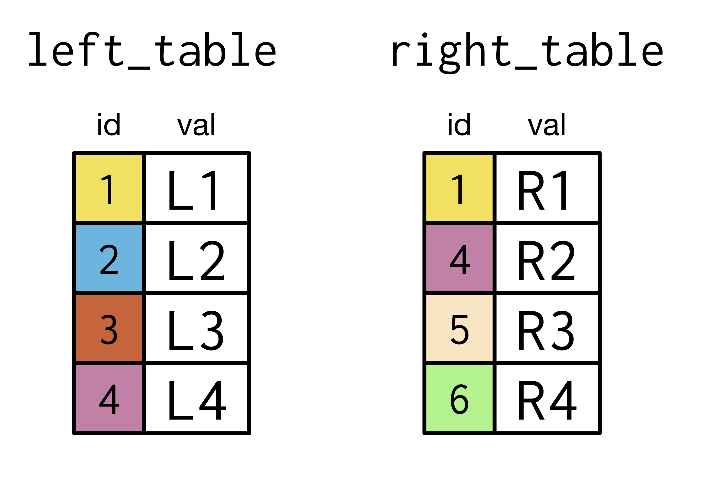
INNER JOIN

Slide 10
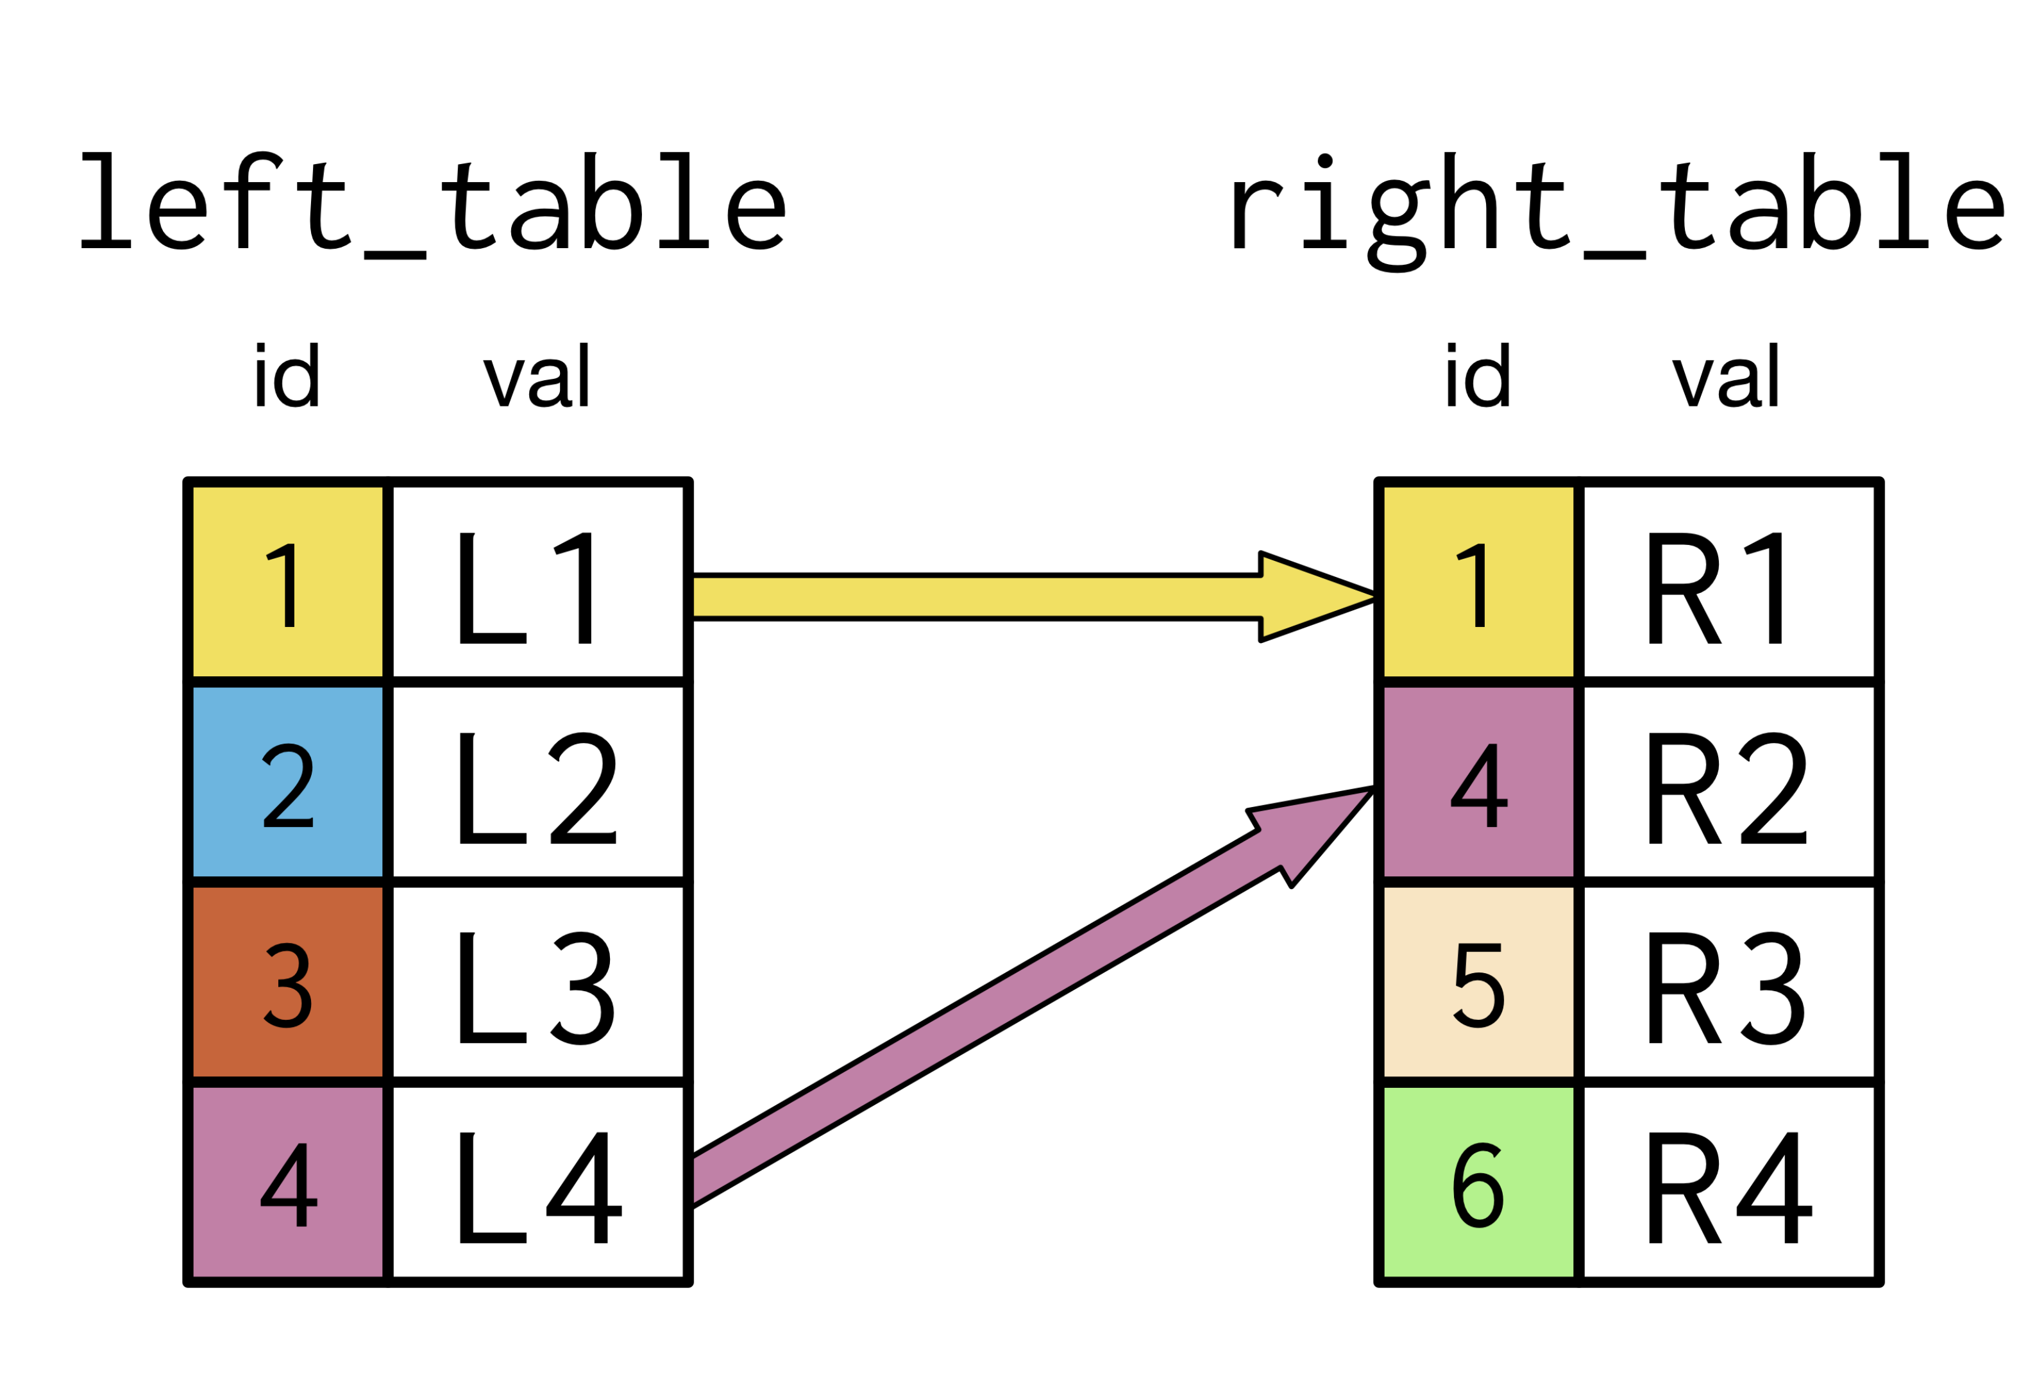
INNER JOIN

Slide 11
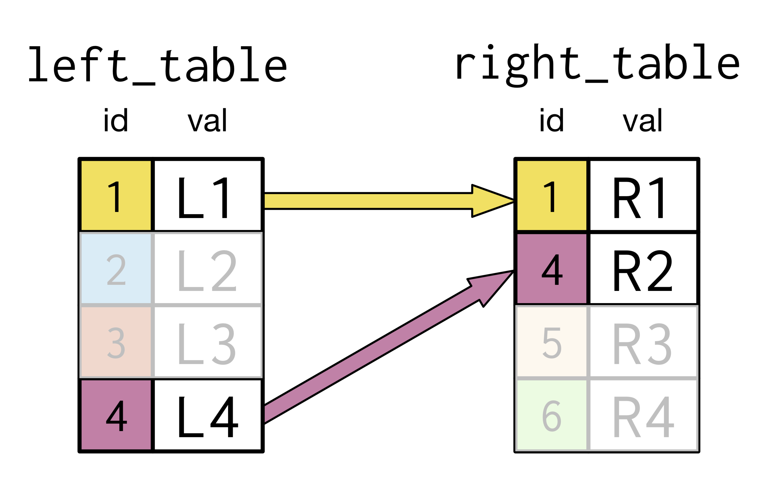
INNER JOIN

Slide 12
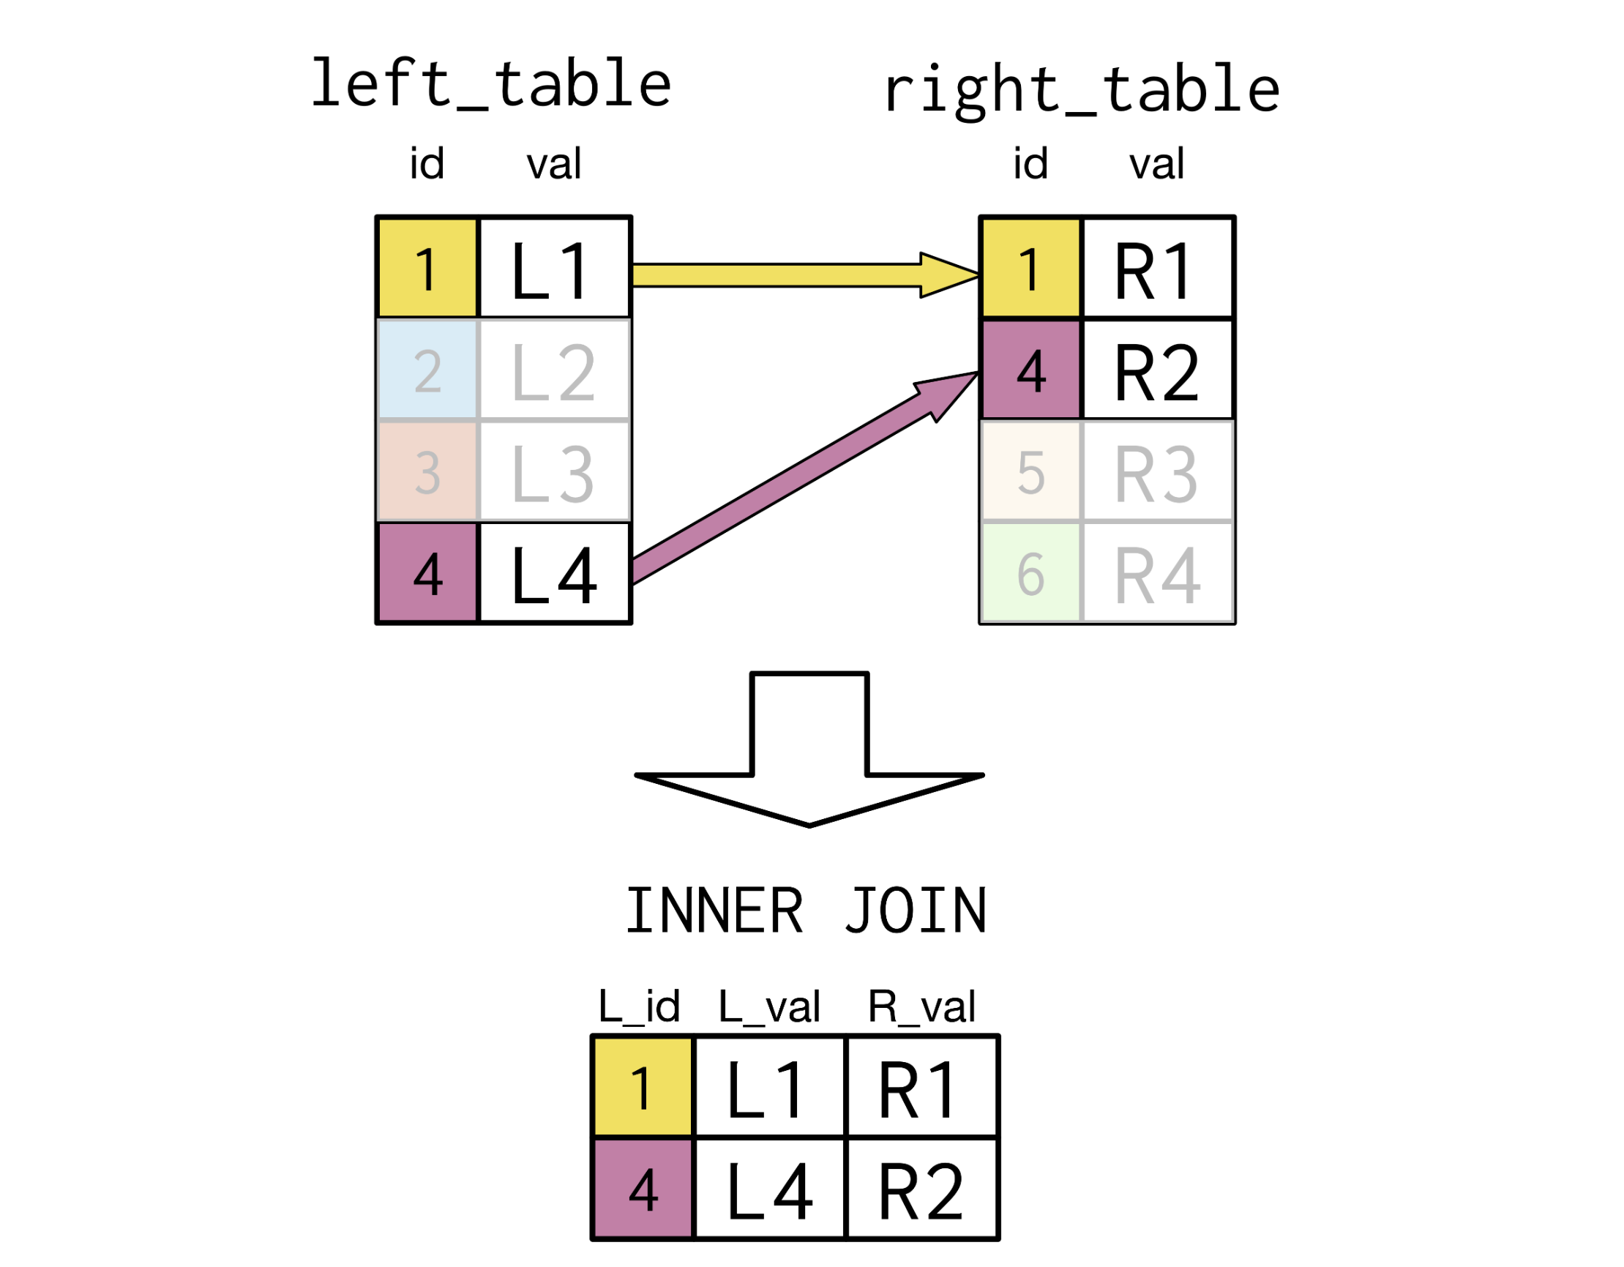
INNER JOIN 1:1

Slide 13
INNER JOIN 1:N

Slide 14
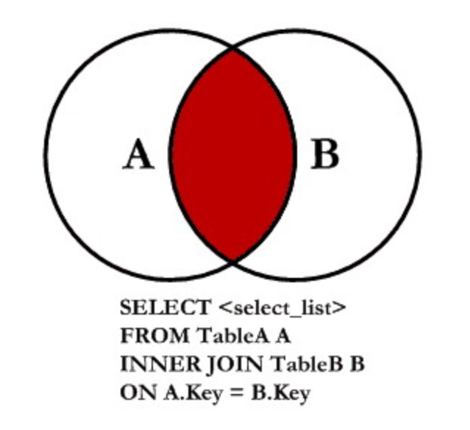
INNER JOIN FORM

Slide 15
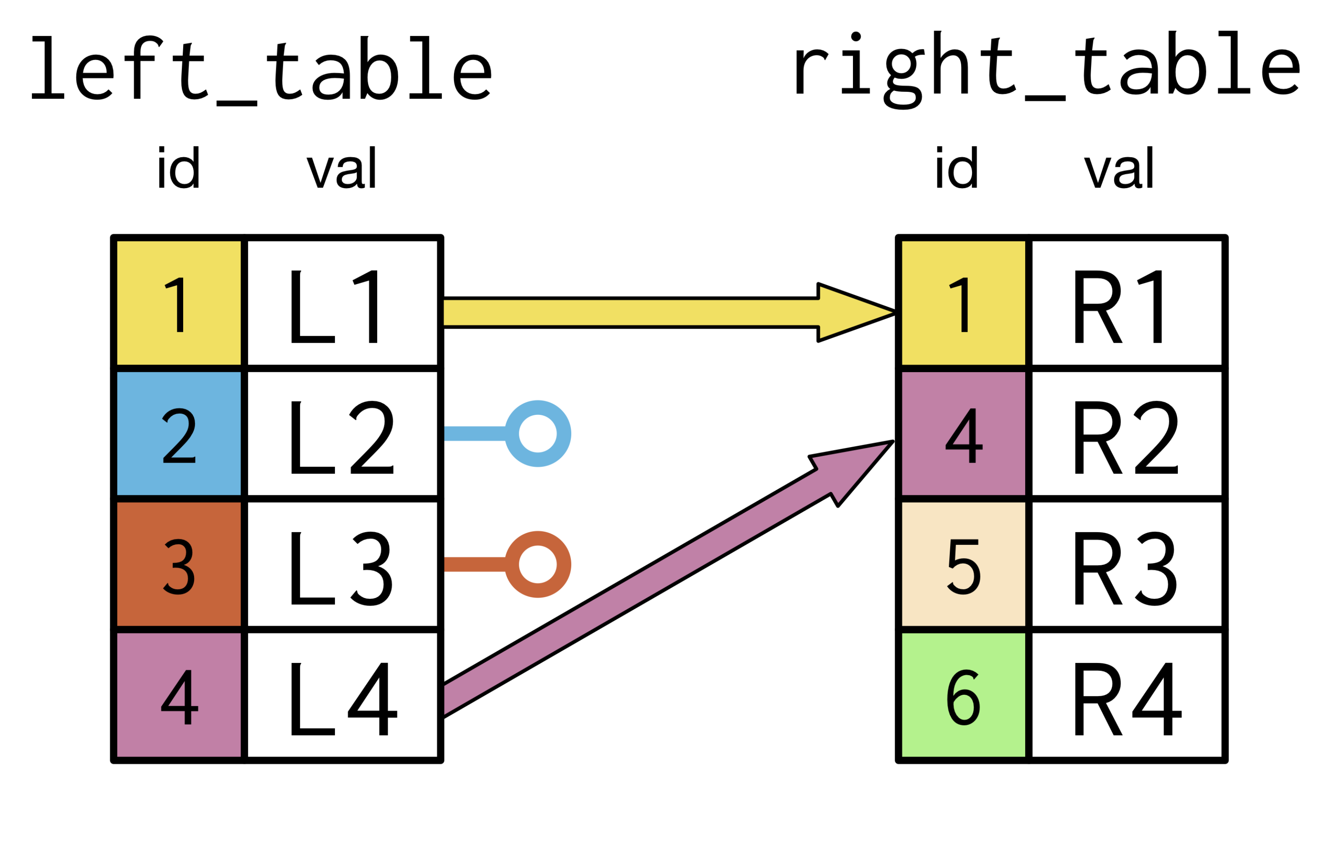
LEFT JOIN

Slide 16
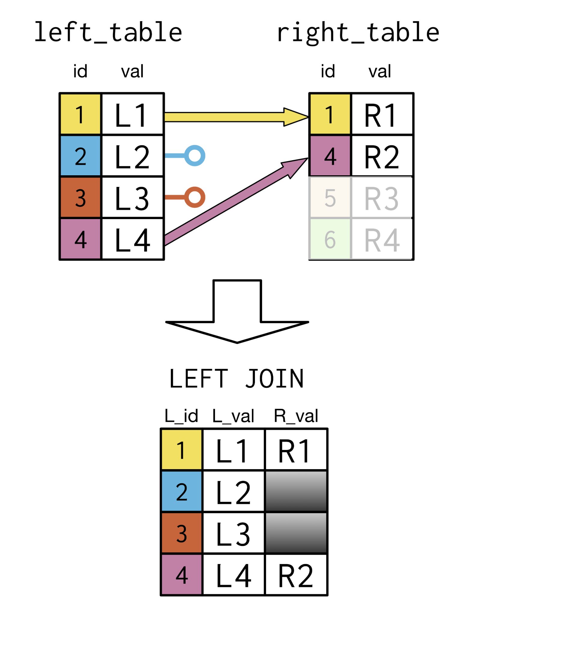
LEFT JOIN 1:1

Slide 17
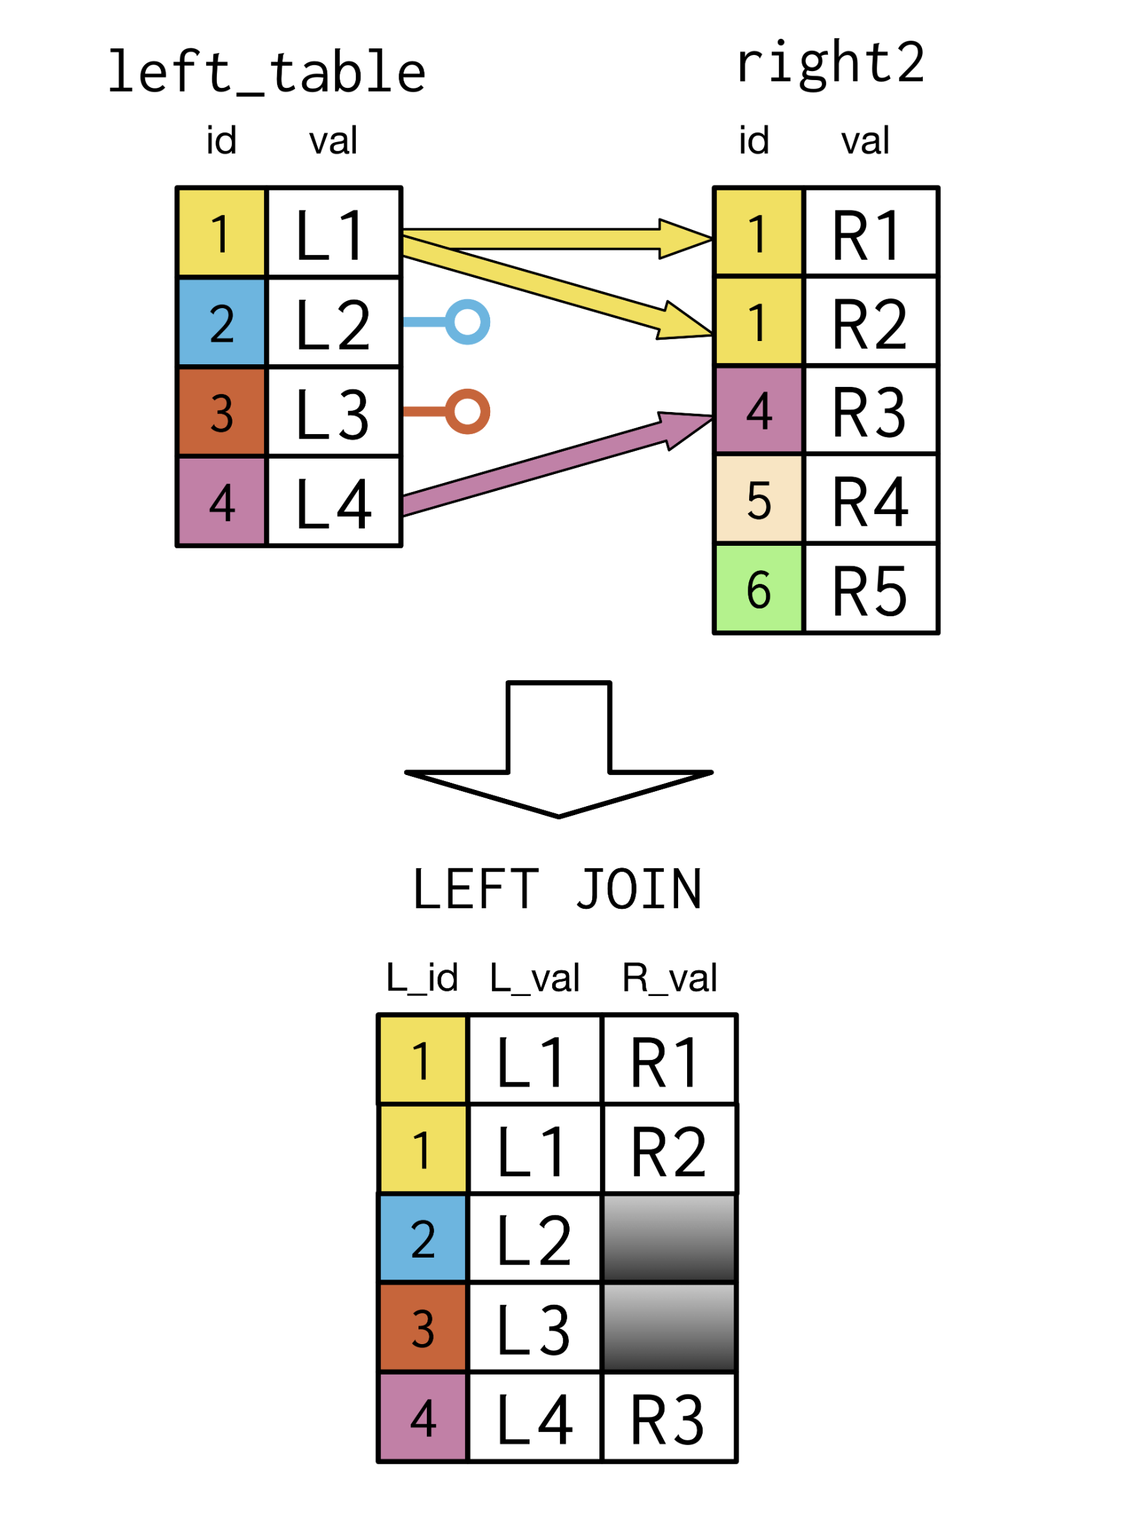
LEFT JOIN 1:N

Slide 18
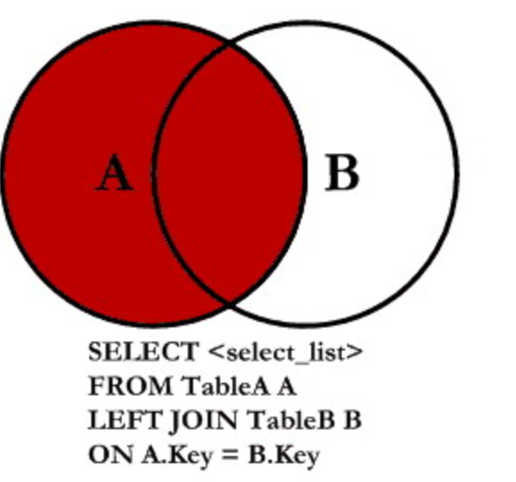
LEFT JOIN FORM

Slide 19
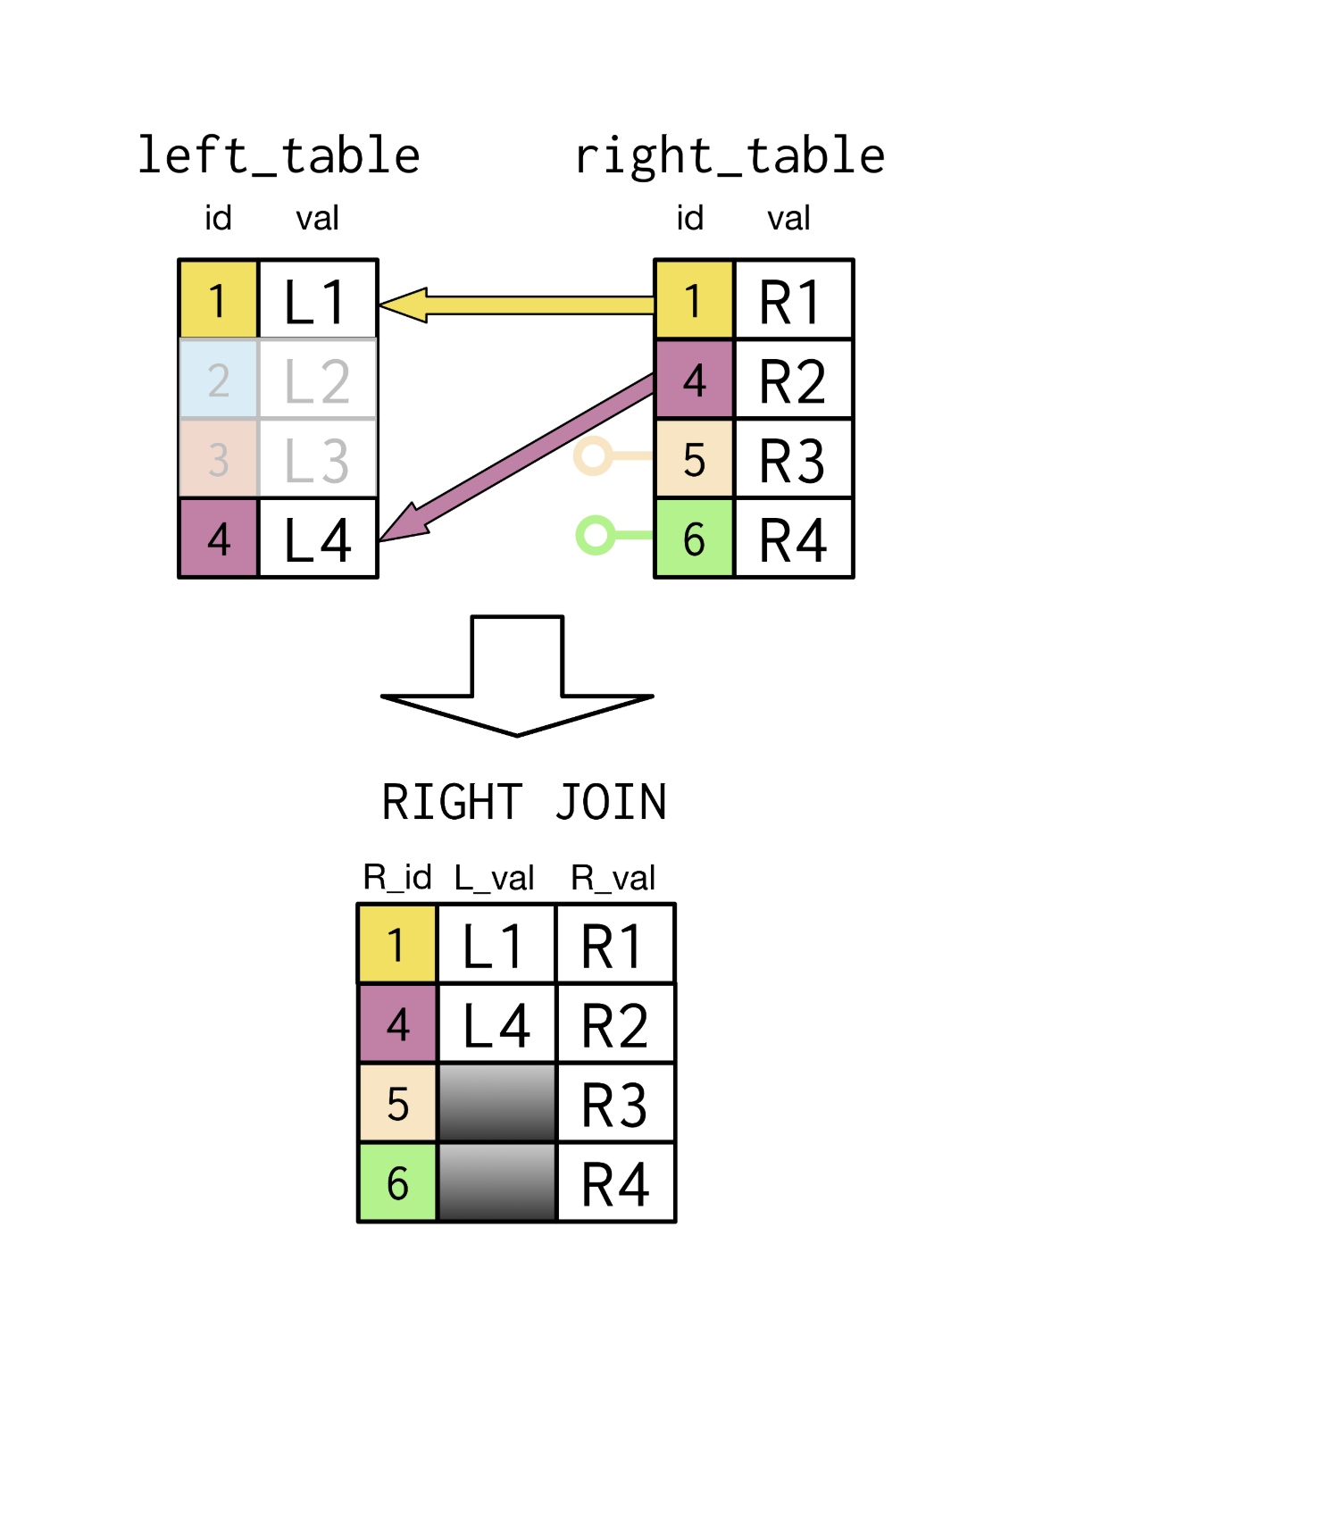
RIGHT JOIN

Slide 20
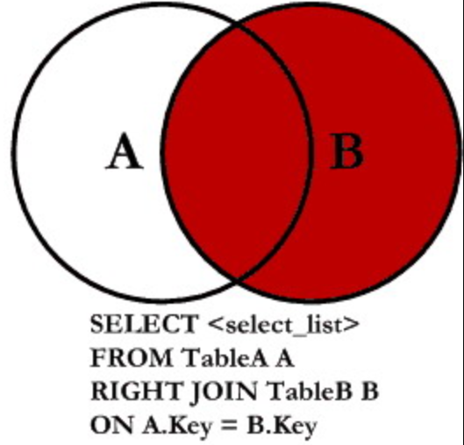
RIGHT JOIN FORM

Slide 21
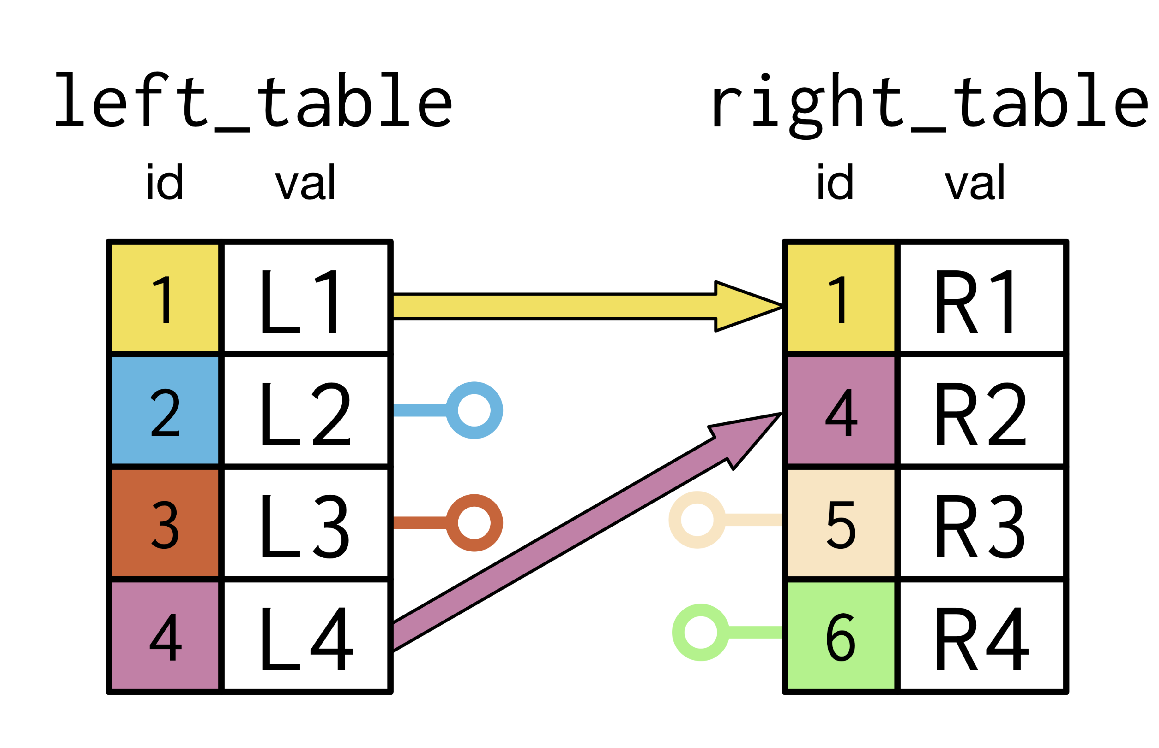
FULL JOIN

Slide 22
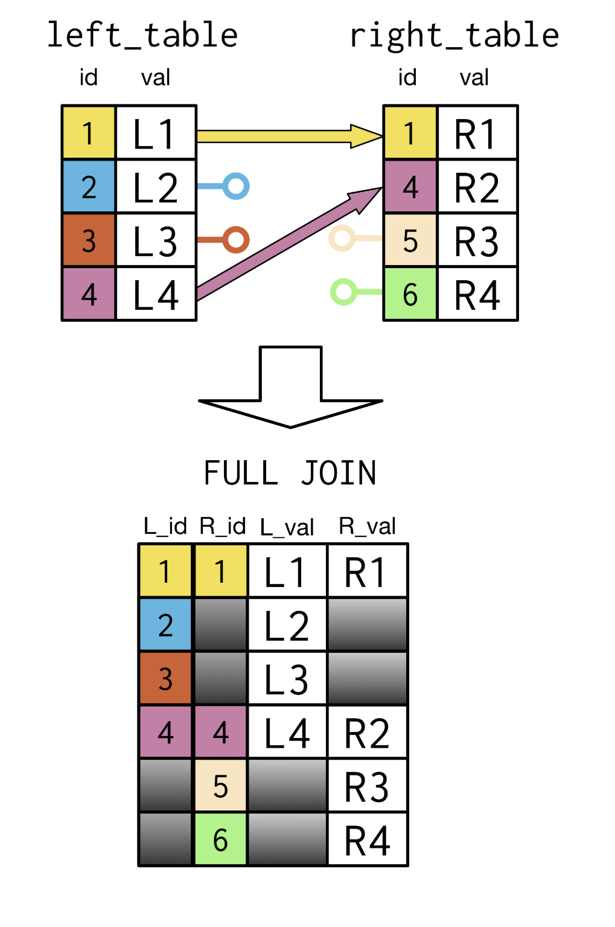
FULL JOIN

Slide 23
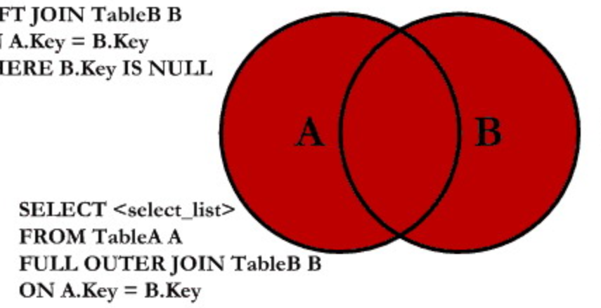
FULL JOIN FORM

