Slide 1
DATA ENGINEERING 1
NOSQL
Laszlo Sallo
OCTOBER 2024

Slide 2
NOSQL

Slide 3
INTEGRITY AND CONSISTENCY
BASICALLY AVAILABLE
SOFT STATE
EVENTUAL CONSISTENCY
BASE

Slide 4
INTERFACE
SQL
ActionScript Bash C C# C++ Clojure Common Lisp Crystal D Dart Delphi Elixir emacs lisp Erlang Fancy gawk GNU Prolog Go Haskell Haxe Io Java Julia Lasso Lua Matlab mruby Nim Node.js Objective-C OCaml Pascal Perl PHP PL/SQL Pure Data Python R Racket Rebol Ruby Rust Scala Scheme Smalltalk Swift Tcl VB VCL Xojo …

Slide 5
SCHEMALESS OR SCHEMA FREE
A SMART DATABASE CAN FIGURE OUT
THE DATATYPE
THE STRUCTURE

Slide 6
ALGORITHMS DEEP IN THE DATABASE
NO NEED TO MINE

Slide 7
MADE FOR CLOUD

Slide 8
NOSQL CLASSIFICATION
KEY-VALUE STORES
TIME SERIES DBMS
DOCUMENT STORES
COLUMN STORES
SEARCH ENGINES
GRAPH DBMS
100s
OF NOSQL
SOLUTIONS

Slide 9
DB-ENGINES.COM
YOUR ULTIMATE SOURCE TO
EXPLORE
http://db-engines.com/en/system/MySQL
http://db-engines.com/en/system/Elasticsearch
CATEGORIZE / KNOW THE TRENDS
http://db-engines.com/en/ranking_categories
http://db-engines.com/en/ranking_osvsc
http://db-engines.com/en/ranking_trend
COMPARE
http://db-engines.com/en/system/Elasticsearch%3BMongoDB

Slide 10
THE NEW TOOLS
NOSQL
SET OF SOLUTIONS
PERFORMANCE ORIENTED
DATABASE
OPERATIONAL AND ANALYTICAL
STRUCTURED/ SEMI-STRUCTURED
BIG DATA
SET OF SOLUTIONS
DATA VOLUME ORIENTED
DATA FRAMEWORK
ANALYTICAL
MAINLY UNSTRUCTURED

Slide 11
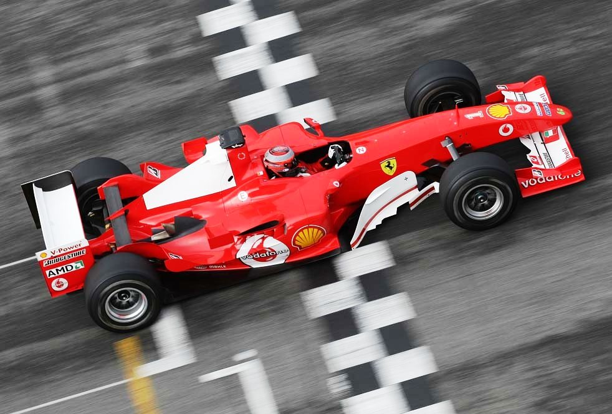
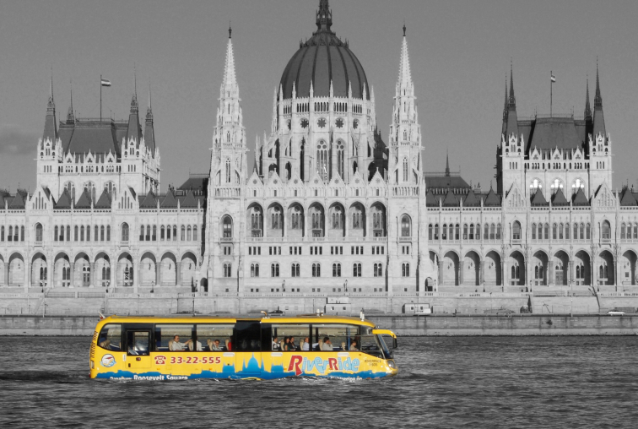
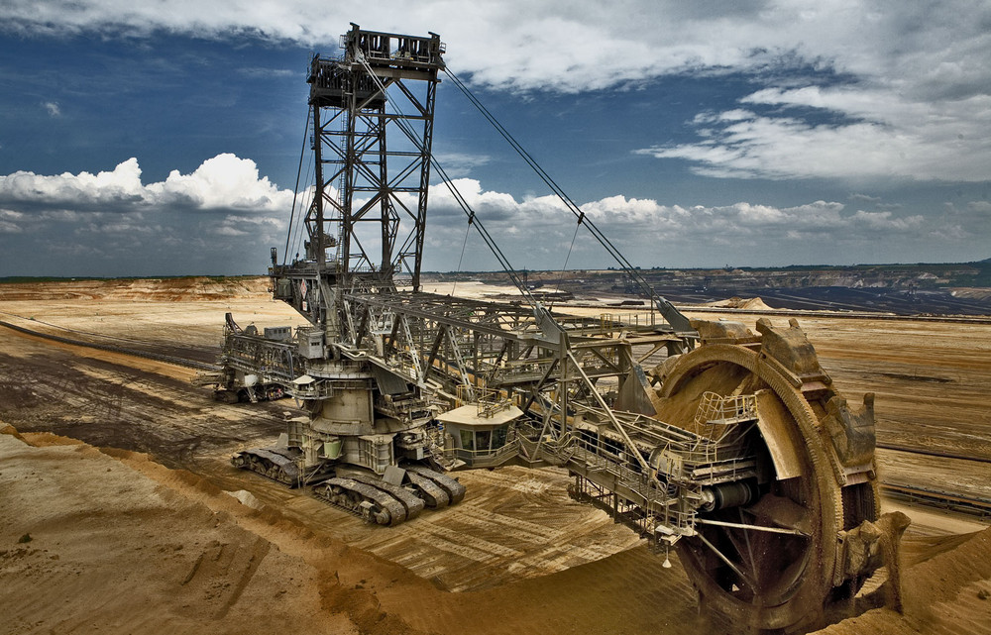
GAME
WHICH ONE YOU
WOULD ASSOCIATE
WITH
RDBMS,
NOSQL,
BIGDATA ?
1
2
3

Slide 12
NOSQL CLASSIFICATION
KEY-VALUE STORES
TIME SERIES DBMS
DOCUMENT STORES
COLUMN STORES
SEARCH ENGINES
GRAPH DBMS

Slide 13
KEY-VALUE DATA FORM - EXAMPLES
key | value
1 | John
2 | Mary
3 | Peter
key | value
War and Peace | ‘Well, Prince, so Genoa and Lucca are now just family …”
The Master and Margarita | “At the sunset hour of one warm spring day two men were to be seen …”
The Winter of Our Discontent | “I wonder how many people I've looked at all my life and never seen.”

Slide 14
KEY-VALUE STORE FEATURES
SIMPLEST DBMS VARIANT
EASY TO SCALE
HIGH PERFORMANCE (MANY TIMES IN MEMORY)

Slide 15
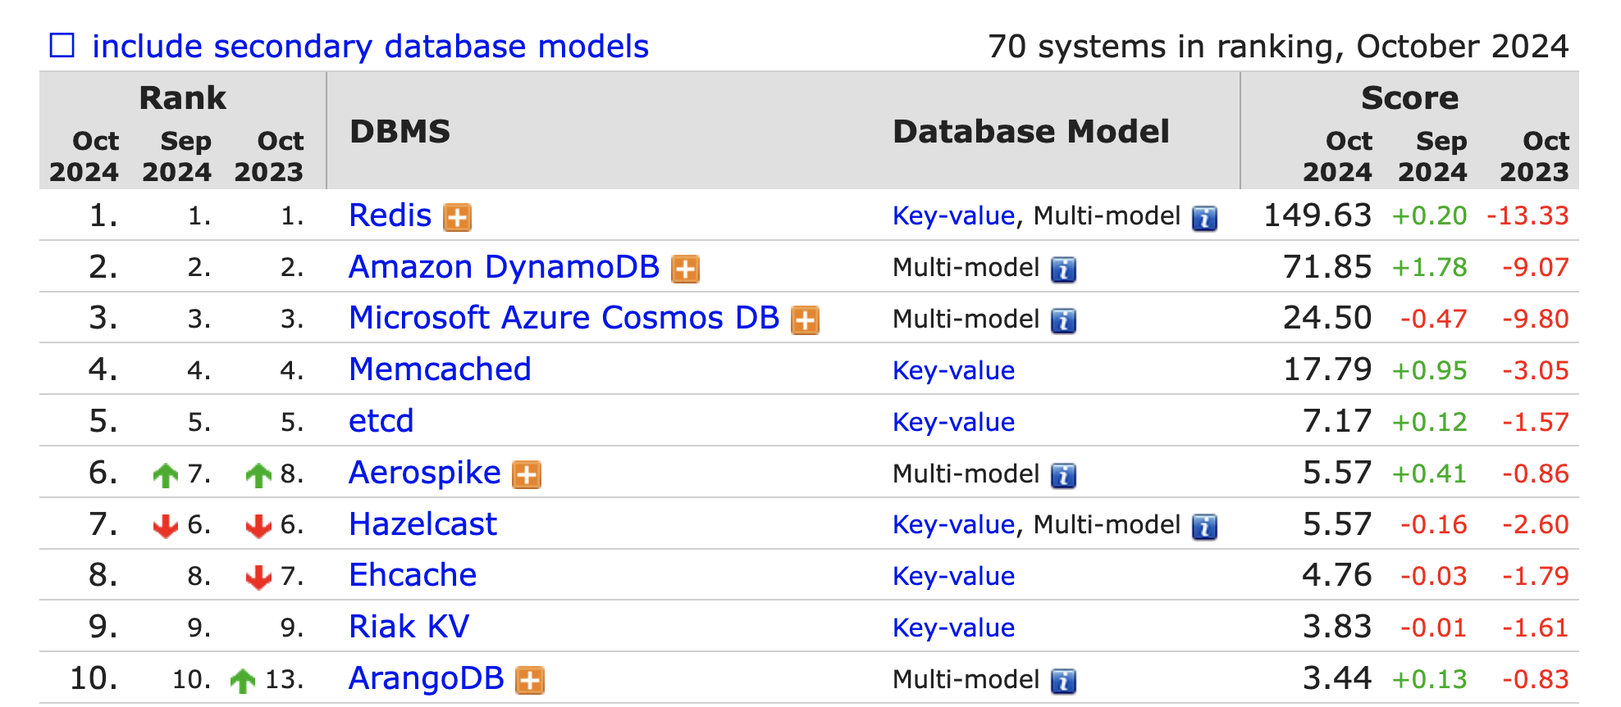
KEY-VALUE STORE RANK

Slide 16
REDIS IN CLOUD

Slide 17
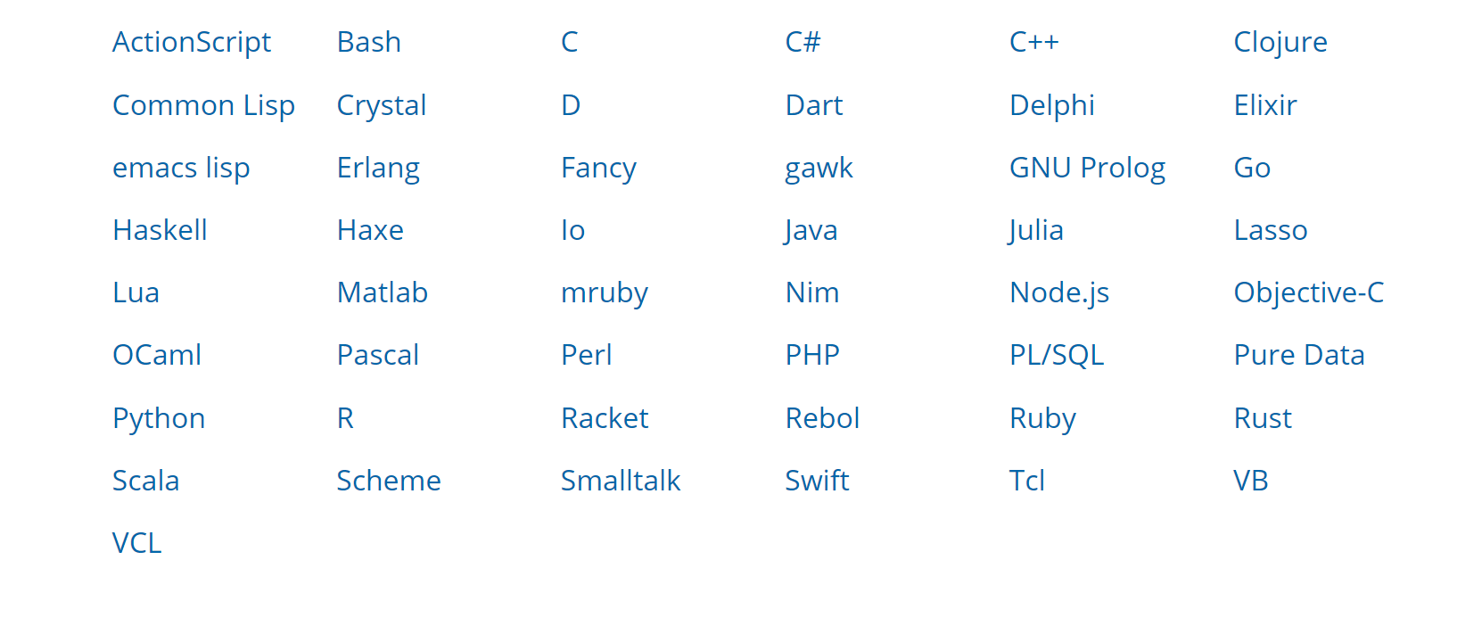
ACCESS REDIS

Slide 18
PRACTICE

Slide 19
NOSQL CLASSIFICATION
KEY-VALUE STORES
TIME SERIES DBMS
DOCUMENT STORES
COLUMN STORES
SEARCH ENGINES
GRAPH DBMS

Slide 20
TIME SERIES DBMS
KEY: TIME
VALUE: TIME SERIES DATA (e.g. MEASUREMENT)

Slide 21
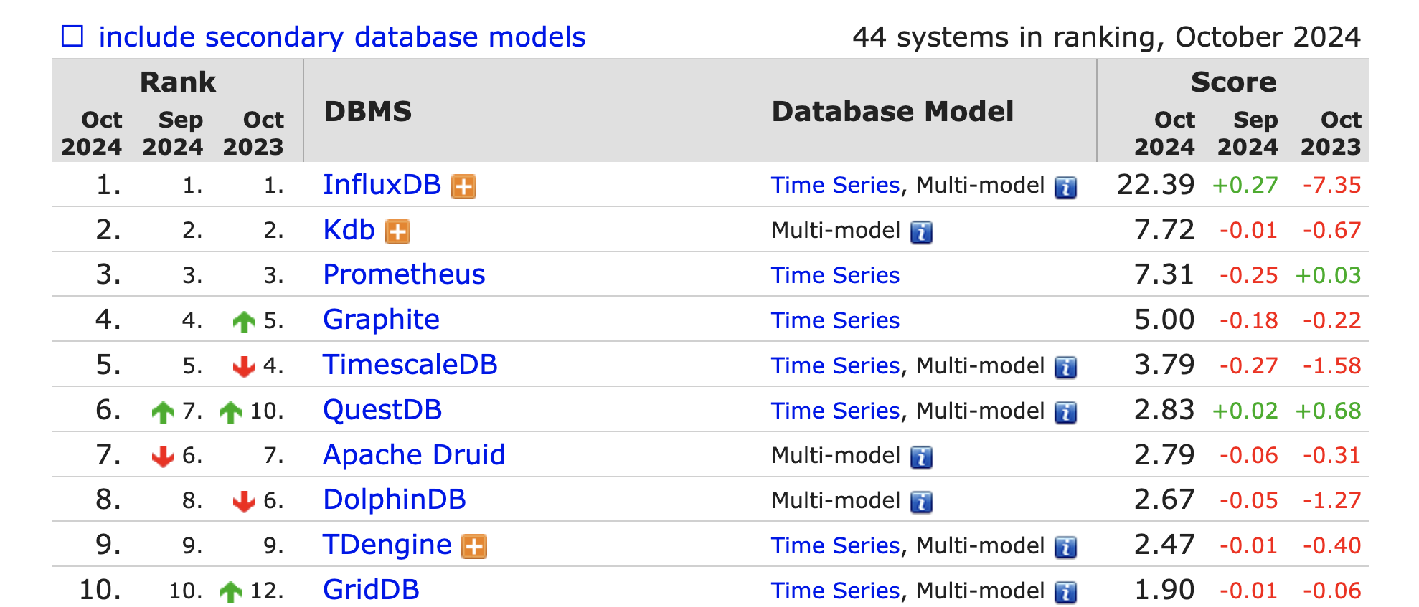
TIME SERIES DBMS

Slide 22
INFLUX DB FUNCTIONS
Aggregations | Selectors | Transformations | Predictors | Technical Analysis
COUNT() | BOTTOM() | ABS() | HOLT_WINTERS() | CHANDE_MOMENTUM_OSCILLATOR()
DISTINCT() | FIRST() | ACOS() |  | EXPONENTIAL_MOVING_AVERAGE()
INTEGRAL() | LAST() | ASIN() |  | DOUBLE_EXPONENTIAL_MOVING_AVERAGE()
MEAN() | MAX() | ATAN() |  | KAUFMANS_EFFICIENCY_RATIO()
MEDIAN() | MIN() | ATAN2() |  | KAUFMANS_ADAPTIVE_MOVING_AVERAGE()
MODE() | PERCENTILE() | CEIL() |  | TRIPLE_EXPONENTIAL_MOVING_AVERAGE()
SPREAD() | SAMPLE() | COS() |  | TRIPLE_EXPONENTIAL_DERIVATIVE()
STDDEV() | TOP() | CUMULATIVE_SUM() |  | RELATIVE_STRENGTH_INDEX()
SUM() |  | DERIVATIVE()
 |  | DIFFERENCE()
 |  | ELAPSED()
 |  | EXP()
 |  | FLOOR()
 |  | HISTOGRAM()
 |  | LN()
 |  | LOG()
 |  | LOG2()
 |  | LOG10()
 |  | MOVING_AVERAGE()
 |  | NON_NEGATIVE_DERIVATIVE()
 |  | NON_NEGATIVE_DIFFERENCE()
 |  | POW()
 |  | ROUND()
 |  | SIN()
 |  | SQRT()
 |  | TAN()

Slide 23
INFLUX TICK STACK

Slide 24
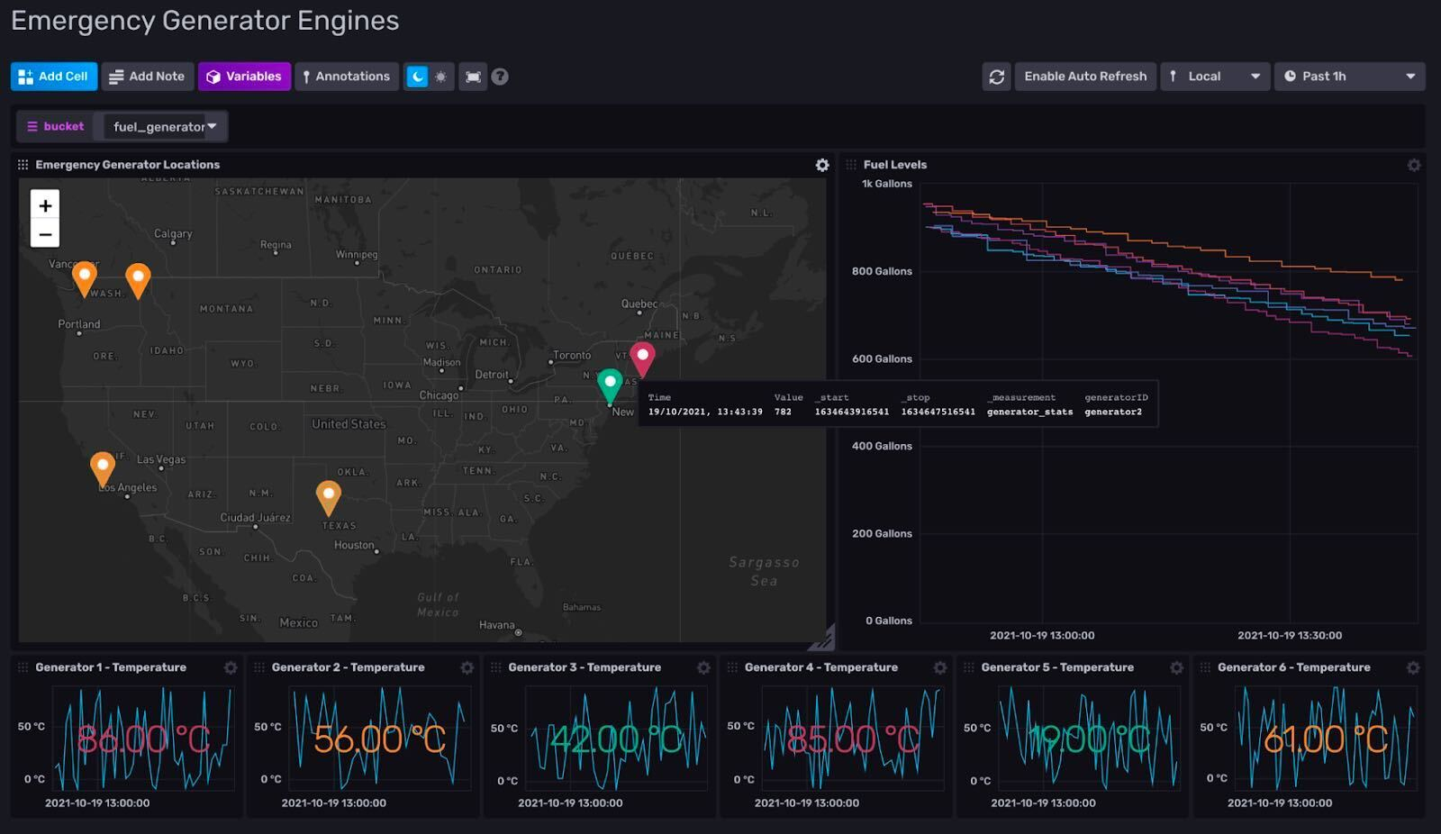
INFLUX TICK STACK

Slide 25
USE CASE EXAMPLE
VISUALIZE
IoT
Metrics Influx
(Aggregate)
PROCESSOR
SENSORS
Event Influx
(Interpret)
QUEUE
PROCESSOR
KEY VALUE
MONITOR

Slide 26
USE CASES
IOT
SYSTEM / INFRASTRUCTURE MONITORING
SMART CITY
INDUSTRY 4.0
ANOMALY DETECTION
TRADING DATA

Slide 27
NOSQL CLASSIFICATION
KEY-VALUE STORES
TIME SERIES DBMS
DOCUMENT STORES
COLUMN STORES
SEARCH ENGINES
GRAPH DBMS

Slide 28
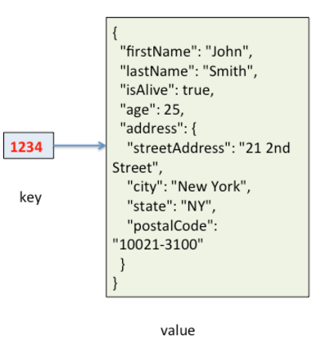
DOCUMENT STORES
KEY: ID
VALUE: QUERYABLE STRUCTURED DOCUMENT

Slide 29
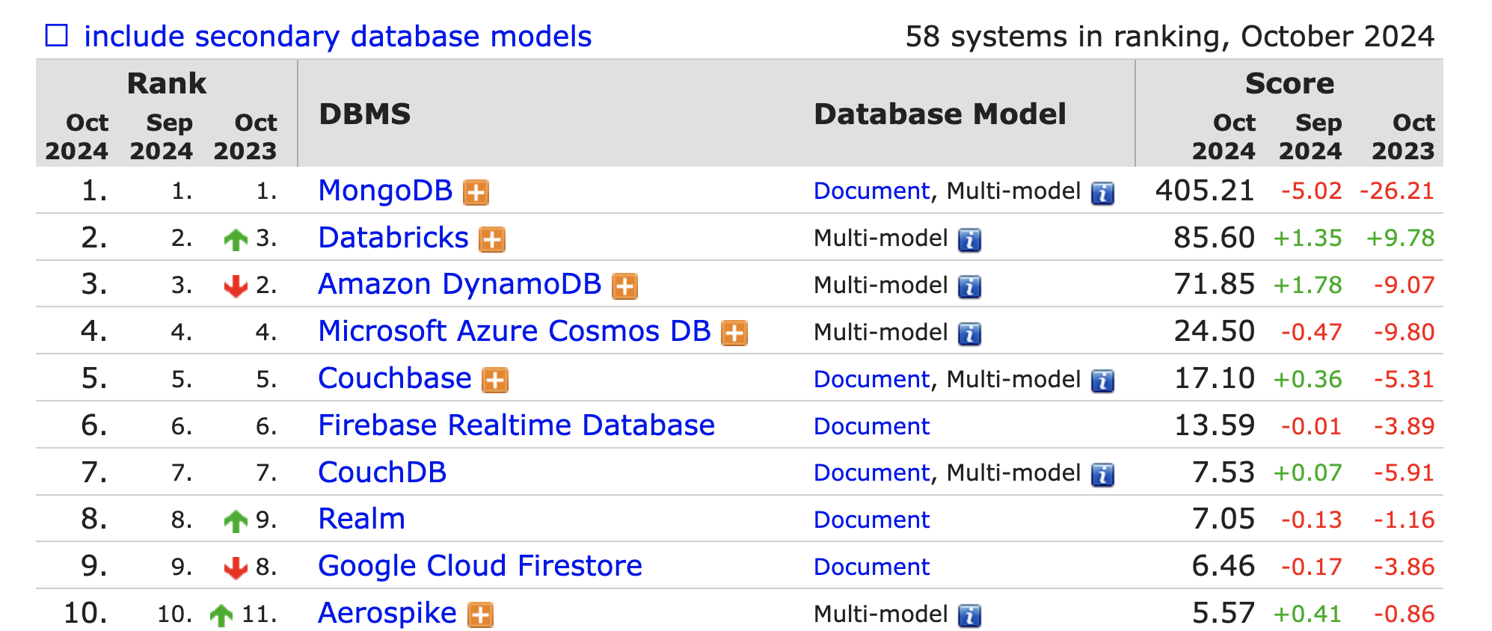
DOCUMENT STORES

Slide 30
MONGODB
THE MOST USED NOSQL
CLOSER TO GENERAL PURPOSE / SLOWER
HIGH AVAILABILITY / AUTOMATIC FAILOVER
HIGHLY SCALABLE / REBALANCING
DYNAMIC SCHEMA

Slide 31
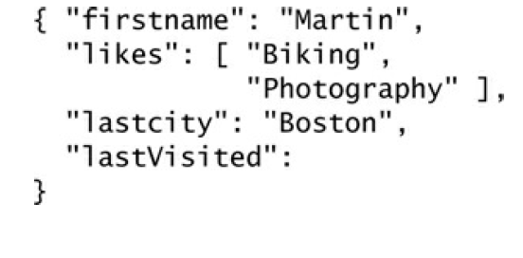
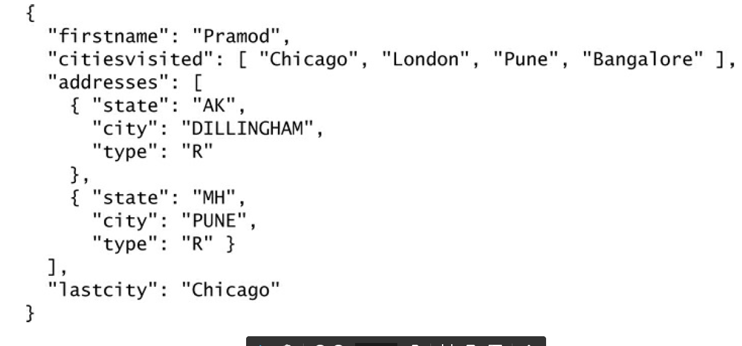
DYNAMIC SCHEMA

Slide 32
MONGO ACCESS
BI TOOLS
PROGRAMING LANGUAGES

Slide 33
USAGE
USE WHEN YOU CAN MAP YOUR DATA IN JSON
DO NOT USE WHEN
MONGO CAN’T HANDLE YOUR DATA SIZE
YOU NEED COMPLEX AGGREGATIONS
YOU HAVE COMPLEX RELATIONS
https://www.mongodb.com/industries/

Slide 34
PRACTICE

Slide 35
NOSQL CLASSIFICATION
KEY-VALUE STORES
TIME SERIES DBMS
DOCUMENT STORES
COLUMN STORES
SEARCH ENGINES
GRAPH DBMS

Slide 36
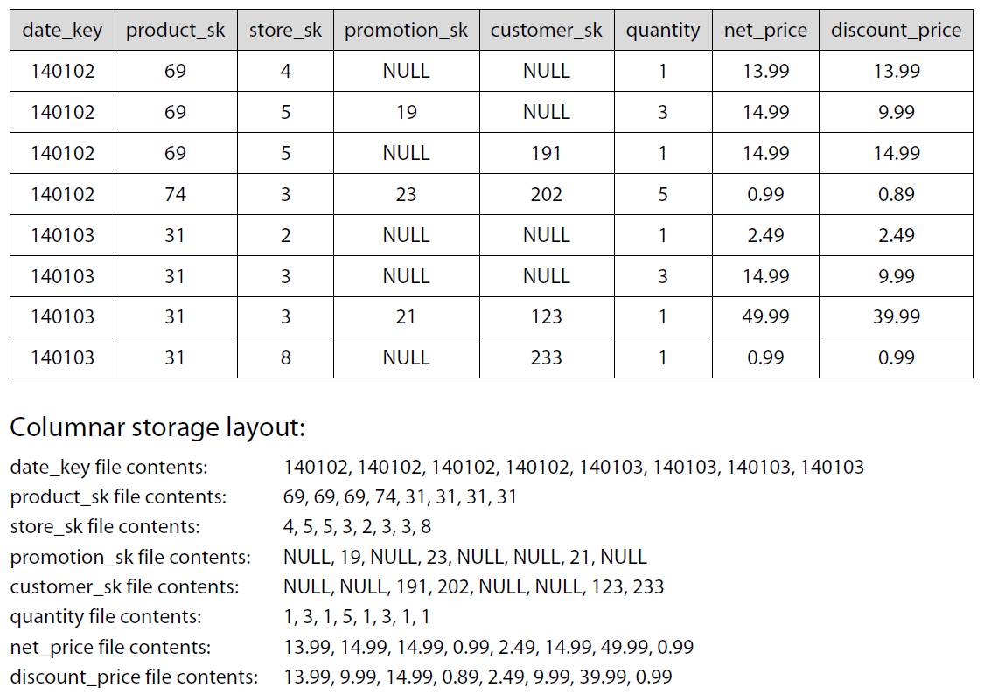
CLASSICAL DATA TABLE
140102 69 4 NULL NULL 1 13.99 13.99 140102 69 5 19 NULL 3 14.99 9.99 140102 69 5 NULL 191 1 14.99 14.99 140102 74 3 23 202 5 0.99 0.89 140103 31 2 NULL NULL 1 2.49 2.49 140103 31 3 NULL NULL 3 14.99 9.99 140103 31 3 21 123 1 49.99 39.99 140103 31 8 NULL 233 1 0.99 0.99
DISCOUNT PRICES FOR PRODUCT 31 ?

Slide 37
WIDE COLUMN STORES

Slide 38
COMPARE DISK ACCESS
CLASSICAL TABULAR DATA
140102 69 4 NULL NULL 1 13.99 13.99 140102 69 5 19 NULL 3 14.99 9.99 140102 69 5 NULL 191 1 14.99 14.99 140102 74 3 23 202 5 0.99 0.89 140103 31 2 NULL NULL 1 2.49 2.49 140103 31 3 NULL NULL 3 14.99 9.99 140103 31 3 21 123 1 49.99 39.99 140103 31 8 NULL 233 1 0.99 0.99
WIDE COLUMN STORES
140102 140102 140102 140102 140103 140103 140103 140103 69 69 69 74 31 31 31 31 4 5 5 3 2 3 3 8 NULL 19 NULL 23 NULL NULL 21 NULL NULL NULL 191 202 NULL NULL 123 233 1 3 1 5 1 3 1 1 13.99 14.99 14.99 0.99 2.49 14.99 49.99 0.99 13.99 9.99 14.99 0.89 2.49 9.99 39.99 0.99

Slide 39
COMPRESSION
CLASSICAL TABULAR DATA
140102 69 4 NULL NULL 1 13.99 13.99 140102 69 5 19 NULL 3 14.99 9.99 140102 69 5 NULL 191 1 14.99 14.99 140102 74 3 23 202 5 0.99 0.89 140103 31 2 NULL NULL 1 2.49 2.49 140103 31 3 NULL NULL 1 14.99 9.99 140103 31 3 21 123 1 49.99 39.99 140103 31 8 NULL 233 1 0.99 0.99
WIDE COLUMN STORES
140102 140102 140102 140102 140103 140103 140103 140103 69 69 69 74 31 31 31 31 4 5 5 3 2 3 3 8 NULL 19 NULL 23 NULL NULL 21 NULL NULL NULL 191 202 NULL NULL 123 233 1 3 1 5 1 1 1 1 13.99 14.99 14.99 0.99 2.49 14.99 49.99 0.99 13.99 9.99 14.99 0.89 2.49 9.99 39.99 0.99

Slide 40
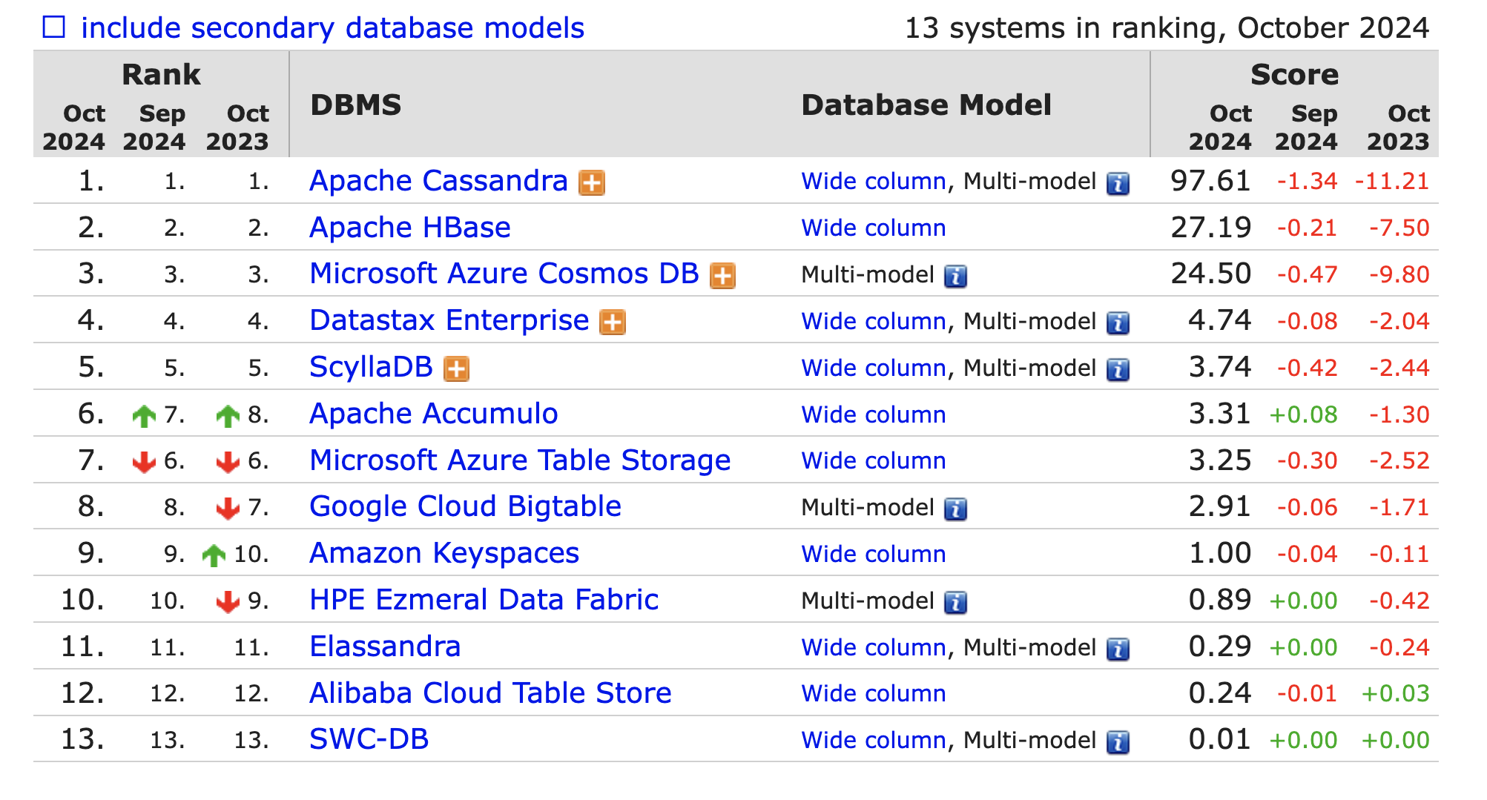
WIDE COLUMN STORE RANK

Slide 41
KEY FEAUTRES
FASTER ACCESS TIME WHEN YOU QUERY A FEW NEED DIMENSIONS
READ OPTIMIZED
HIGHLY SCALABLE BY DIMENSION
COMPRESSION
NEW GENERATION OF DW

Slide 42
NOSQL CLASSIFICATION
KEY-VALUE STORES
TIME SERIES DBMS
DOCUMENT STORES
COLUMN STORES
SEARCH ENGINES
GRAPH DBMS

Slide 43
MANY BUILT-IN FUNCTIONS
Text Analysis
Geospatial Search
Facet search
...
+ Build your own

Slide 44
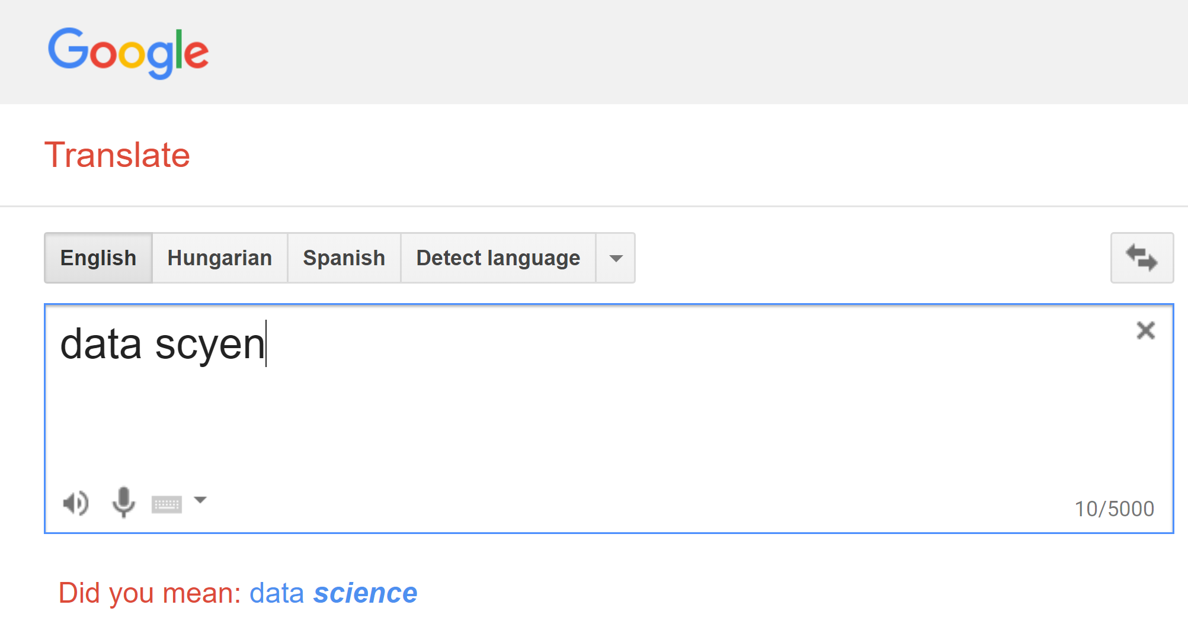
TEXT FUNCTIONS

Slide 45
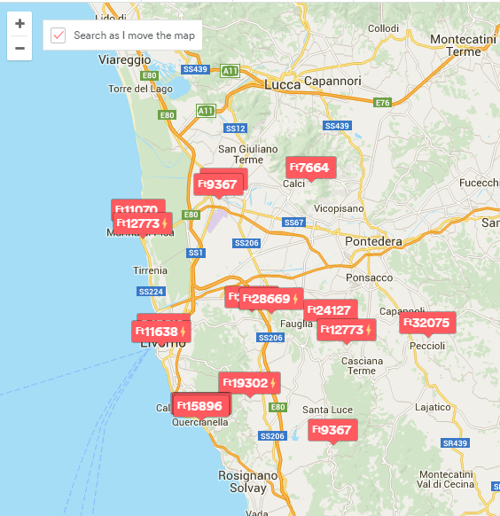
GEOSPATIAL SEARCH
COORDINATES TO EACH RECORD
QUERY:
AREA BY DIFFERENT SHAPES
PROXIMITY

Slide 46
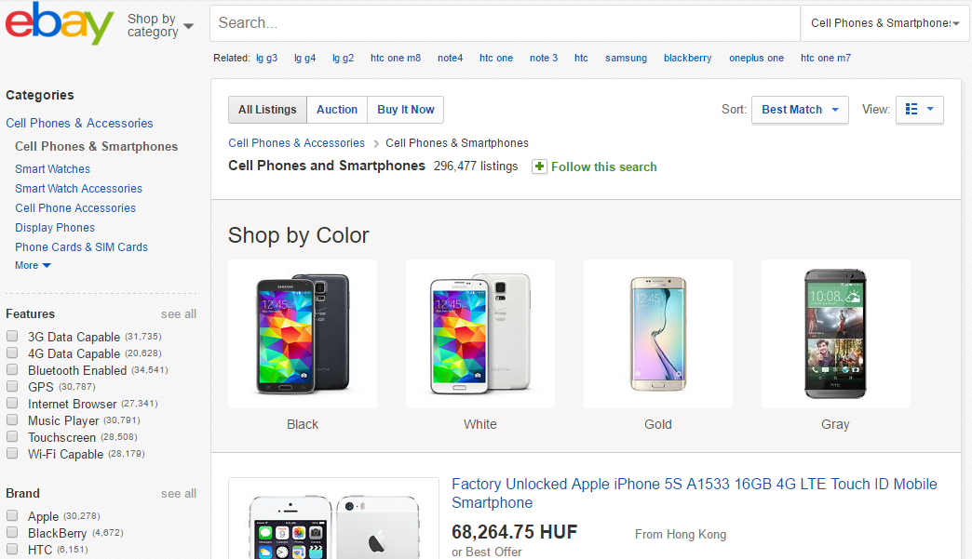
FACETED SEARCH

Slide 47
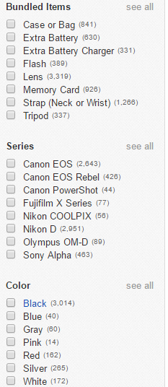
FACETED SEARCH
GUIDED QUERIES
E-COMMERCE: GUIDE YOUR CUSTOMERS
ANALYTICS: SLICING AND DICING, SELF SERVICE BI

Slide 48
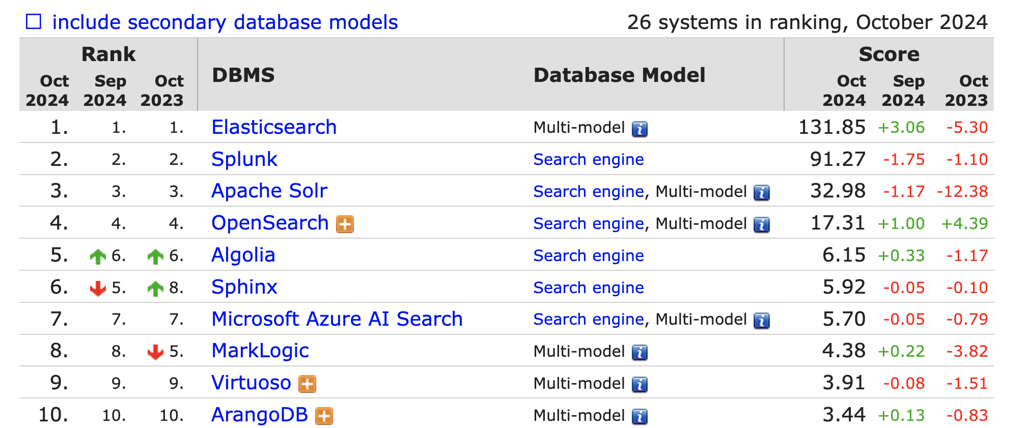
SEARCH ENGINES RANK

Slide 49
PRACTICE

Slide 50
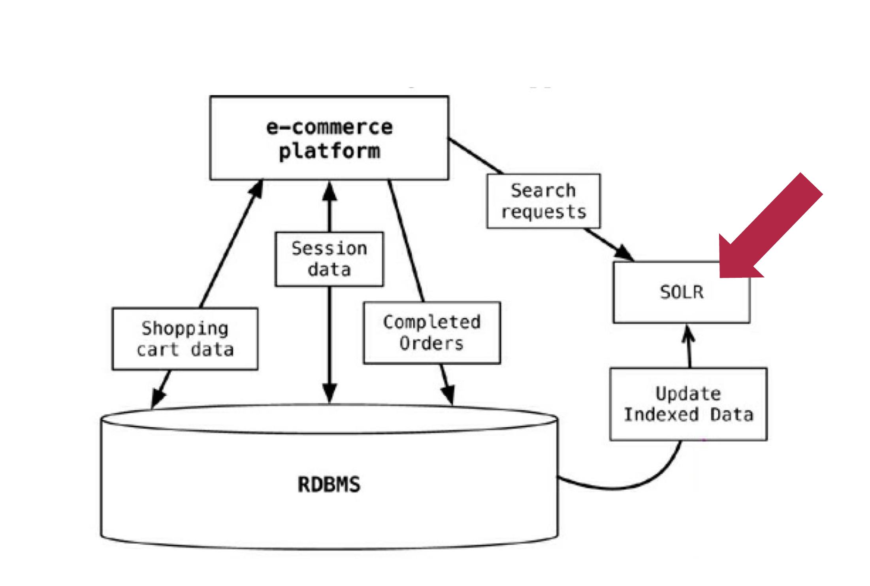
USECASE - ECOMMERCE

Slide 51
NOSQL CLASSIFICATION
KEY-VALUE STORES
TIME SERIES DBMS
DOCUMENT STORES
COLUMN STORES
SEARCH ENGINES
GRAPH DBMS

Slide 52
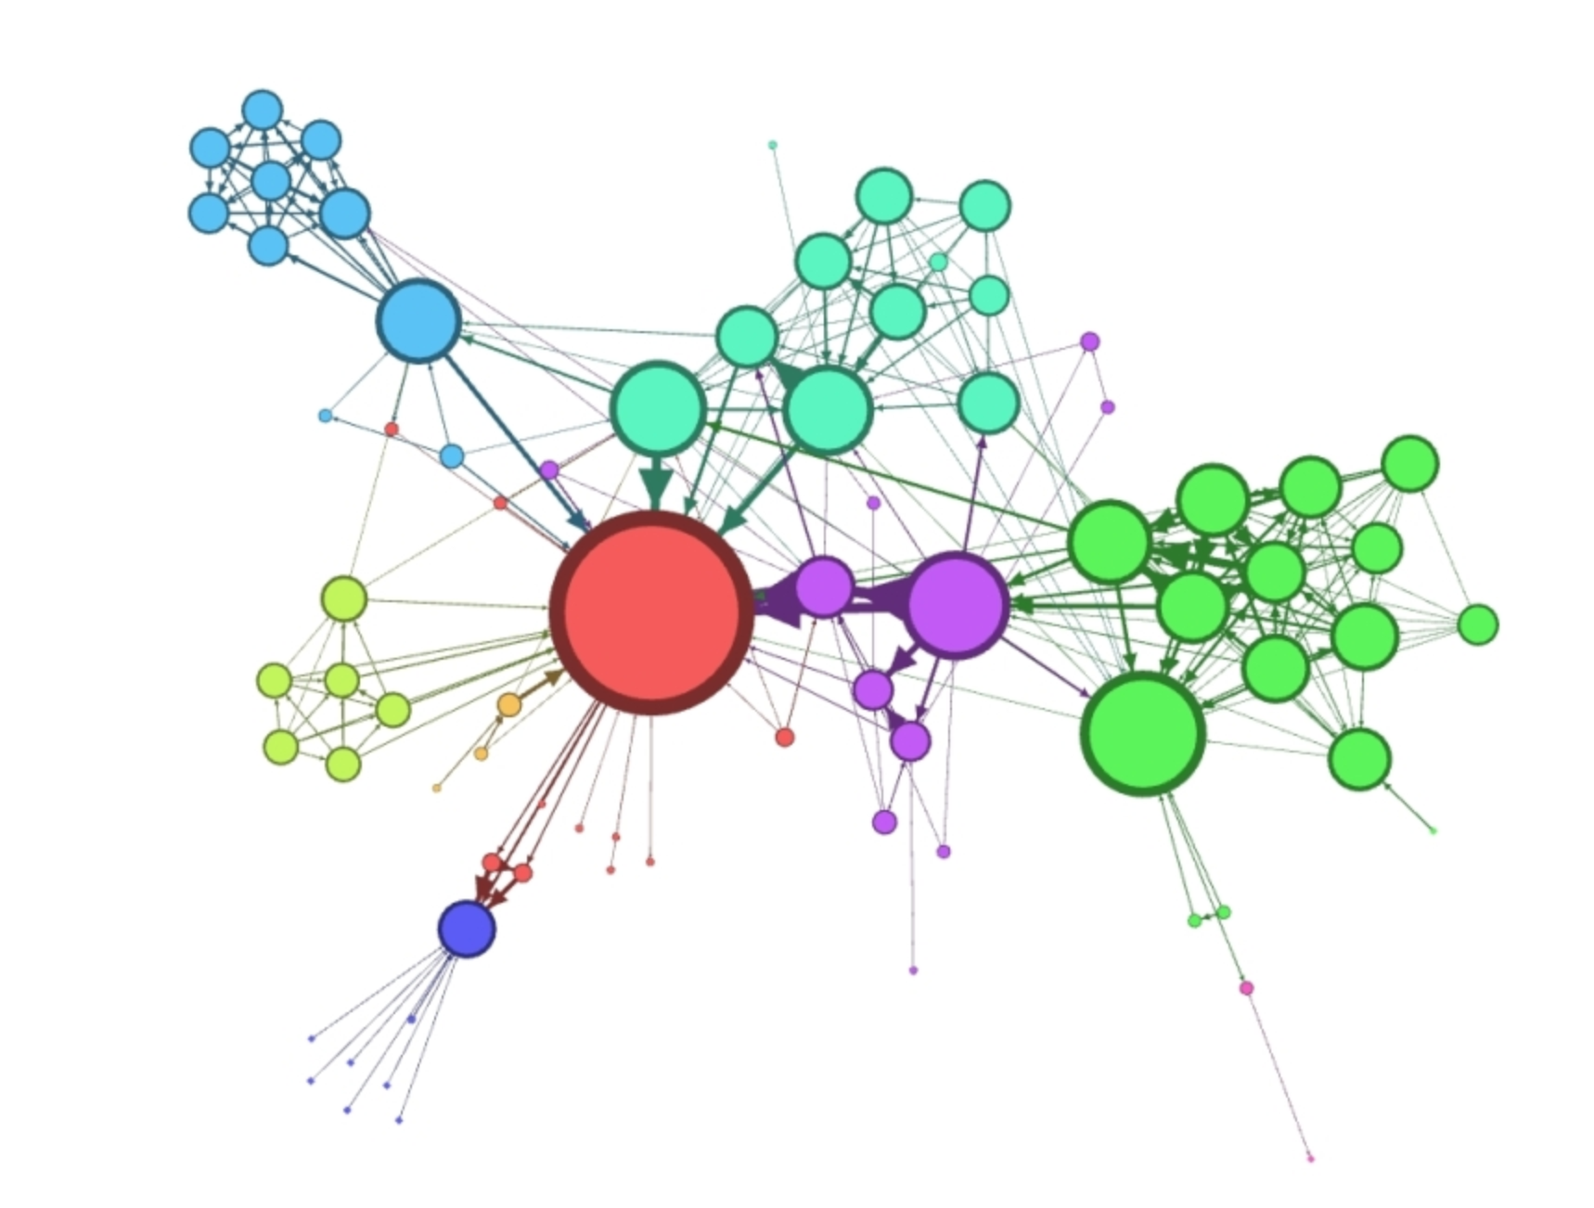
GRAPH DATA STRUCTURES

Slide 53
NETWORK SCIENCE
HOW KEVIN BACON CHANGED DATA SCIENCE ?

Slide 54
BOOKS

Slide 55
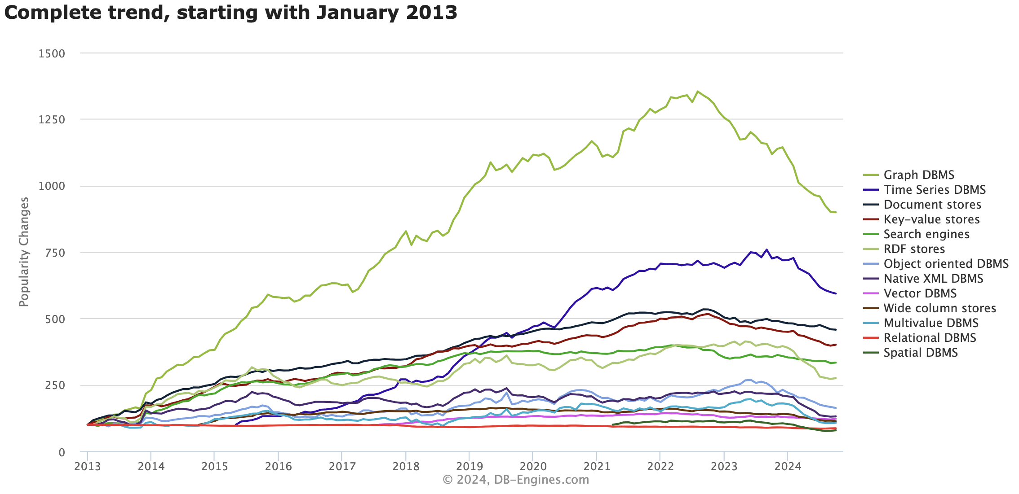
DATA SCIENCE
NEW
TYPE
ANALYTICS

Slide 56
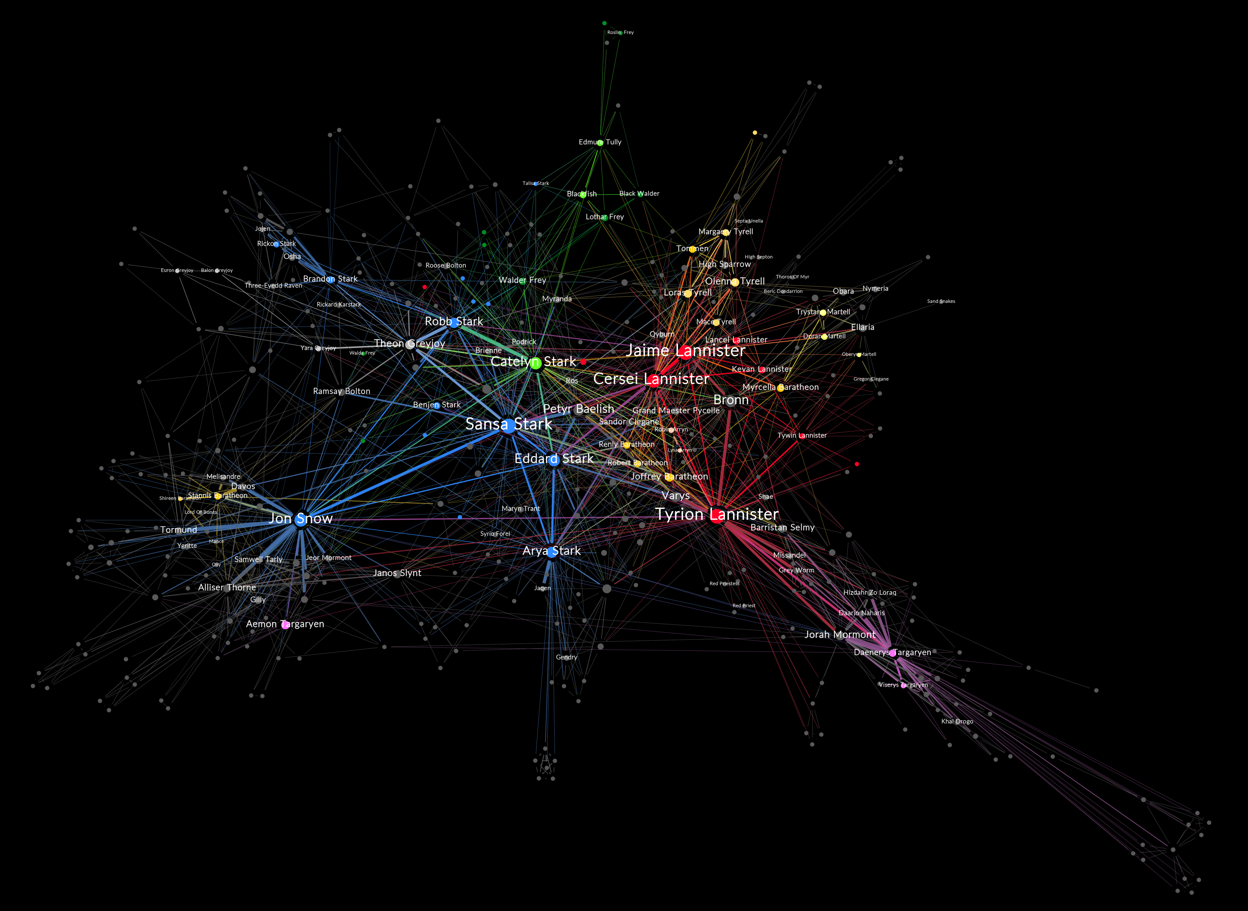
FEATURE ENGINEERING

Slide 57
ROBUSTNESS TESTING
Notes:
INSTEAD OF EXPLORING EMPIRICALLY

Slide 58
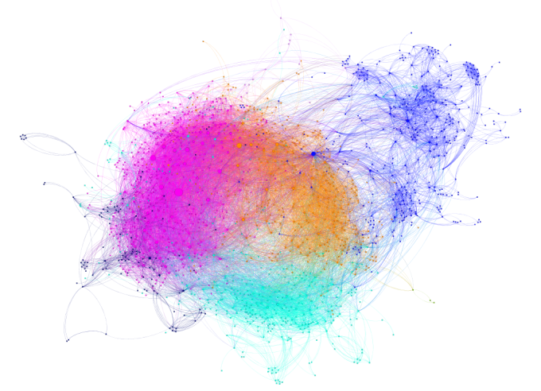
SEGMENTATION / FRAUD DETECTION

Slide 59
RECOMMENDATION ENGINE

Slide 60
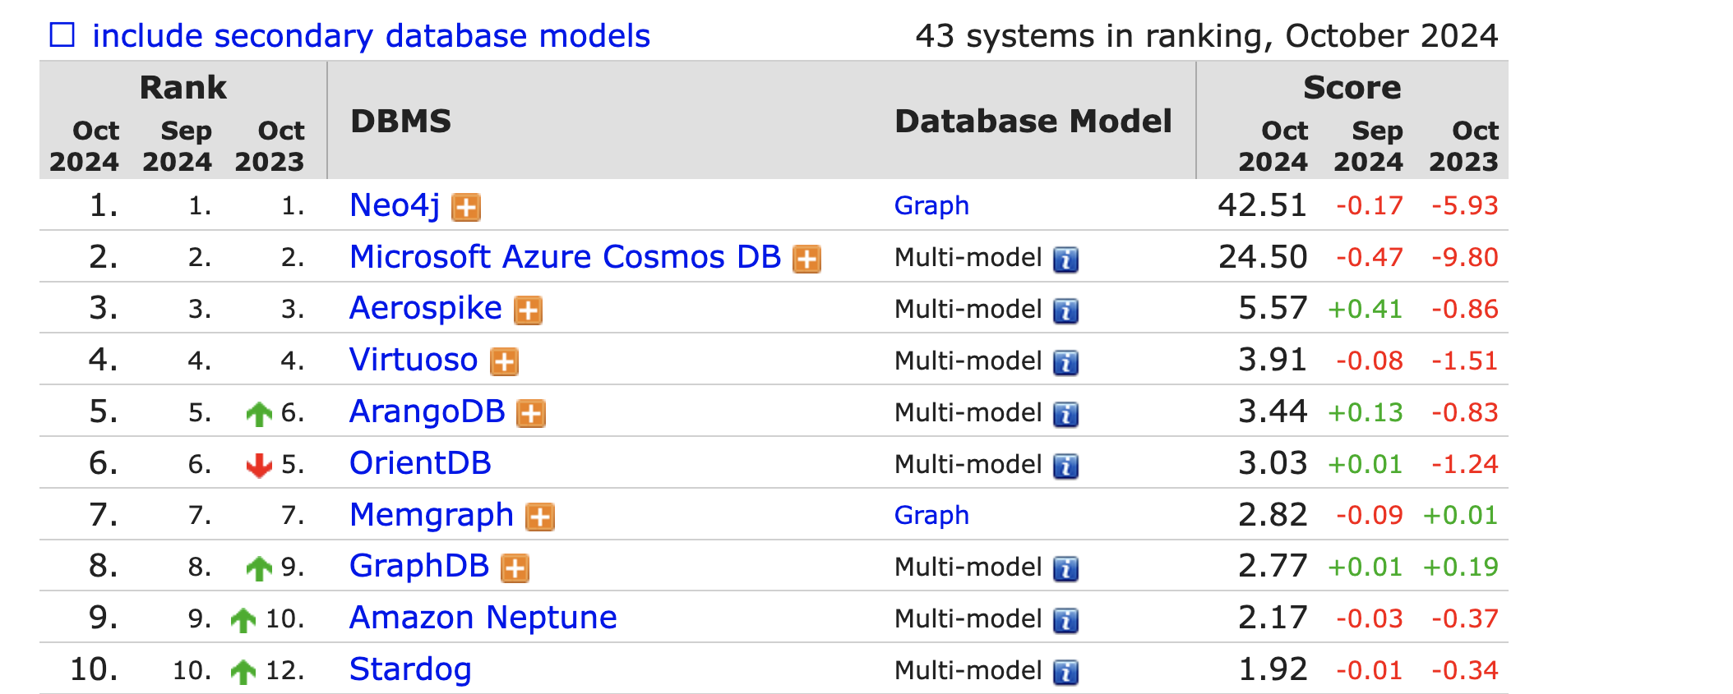
GRAPH DBMS RANK

Slide 61
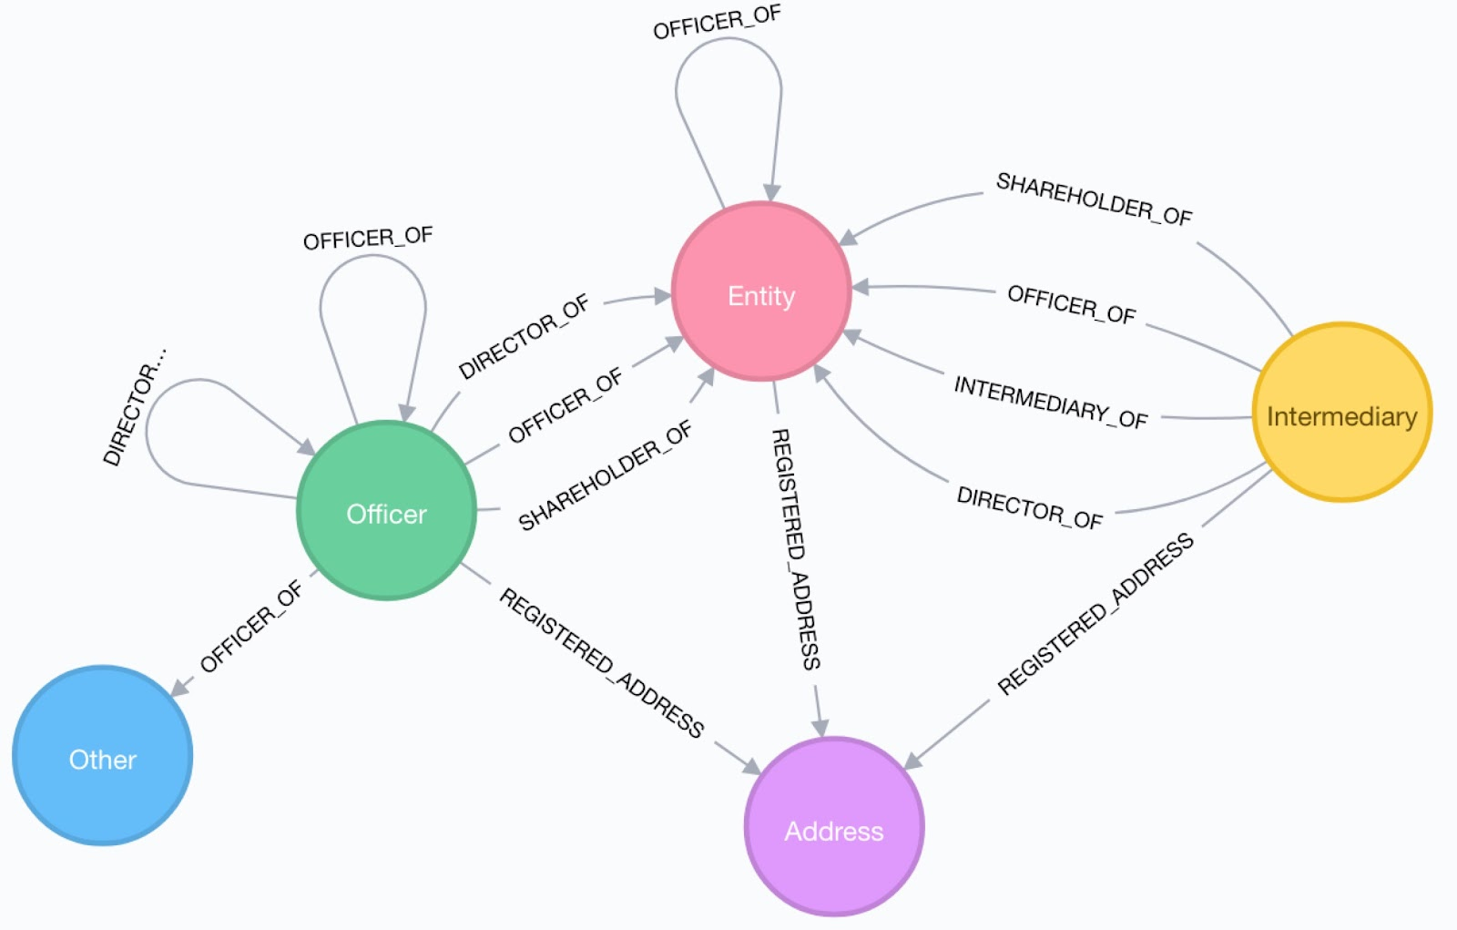
PARADISE PAPERS SCHEMA
Entity - The offshore legal entity. This could be a company, trust, foundation …
Officer - A person or company who plays a role in an offshore entity, such as beneficiary, director, or shareholder.
Intermediary - A go-between for someone seeking an offshore corporation and an offshore service provider — usually a law-firm or a middleman that asks an offshore service provider to create an offshore firm.
Address - The registered address

Slide 62
PRACTICE

Slide 63
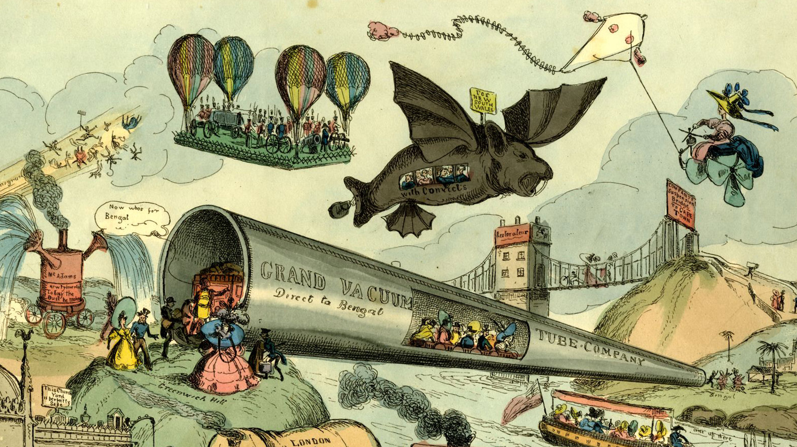
LET’S LOOK BACK
# YOUR FIRST DATABASE
# SQL
# AGGREGATIONS
# JOINS
# DATA MODELLING
# STORED PROCEDURES
# DATA WAREHOUSE
# CSV / JSON
# API
# WORLD BANK / EUROSTAT
# COMMAND LINE BASH
# SENTIMENT ANALYSIS
# KNIME
# CLOUD / AWS
# NOSQL
# SOLR
# NETWORK SCIENCE
# NEO4J
# PARADISE PAPERS

