Slide 1
DATA ENGINEERING 1
TRADEOFFS OF DATA ARCHITECTURES
Laszlo Sallo
OCTOBER 2024

Slide 2
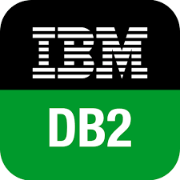
DATA LANDSCAPE BEFORE 2010

Slide 3
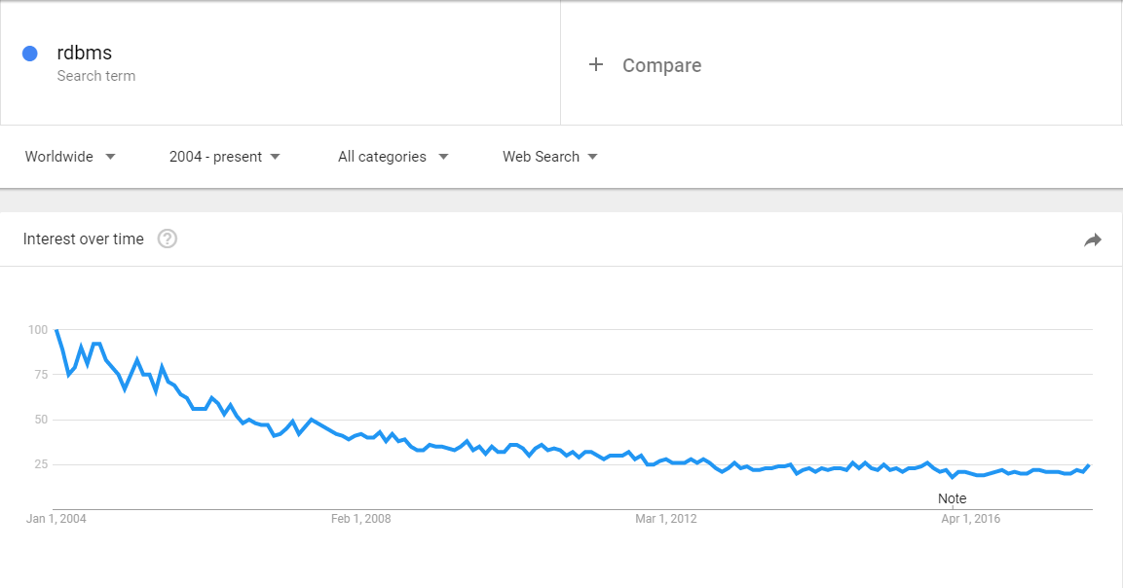
RDBMS

Slide 4
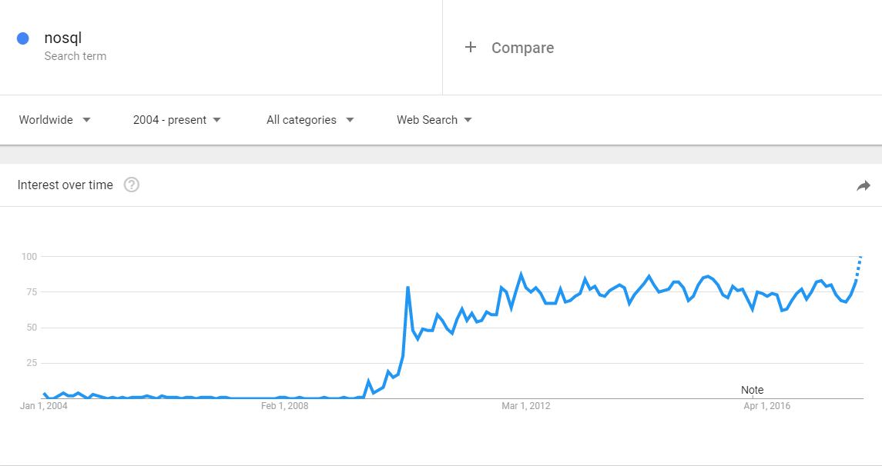
NOSQL

Slide 5
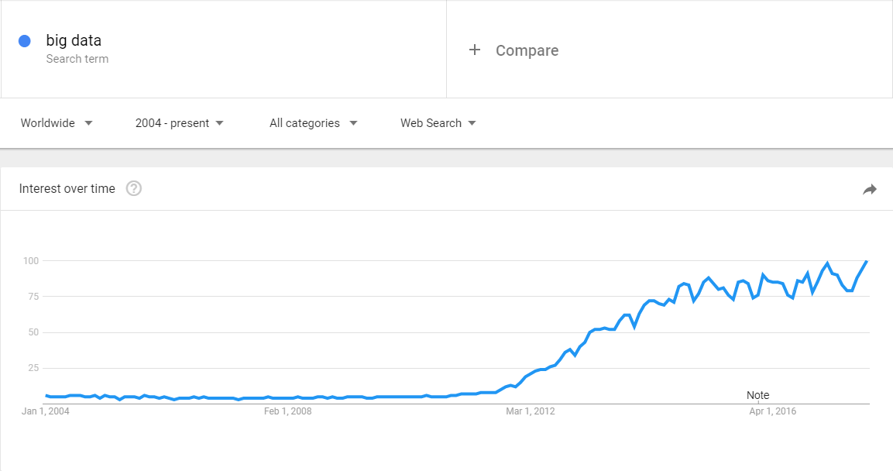
BIG DATA

Slide 6
DATA SYSTEM REVOLUTION IN LATE 2000’S

Slide 7
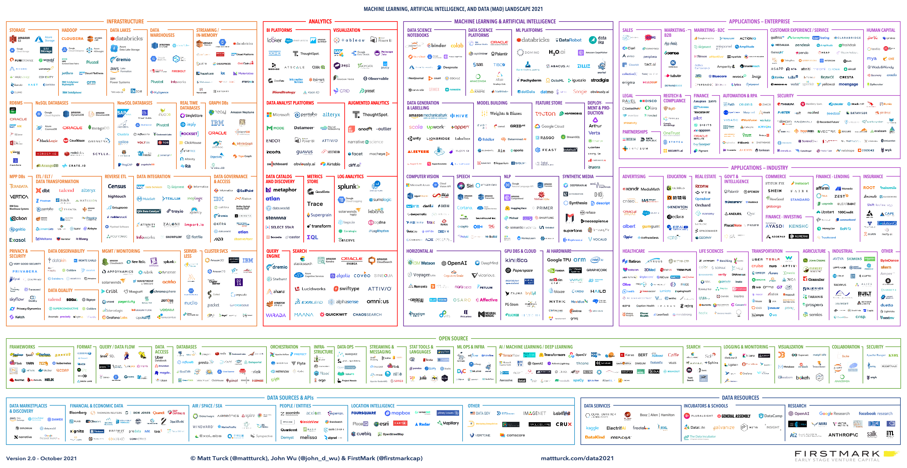

Slide 8
WHAT HAPPENED?
WHAT HAPPENED TO THE WORLD
TO GENERATE SUCH A
CHANGE ?

Slide 9
CHANGE AGENT
SOCIAL MEDIA

Slide 10
CHANGE AGENT
MOBILITY & IoT

Slide 11
CHANGE AGENT
DIGITAL TRANSFORMATION

Slide 12
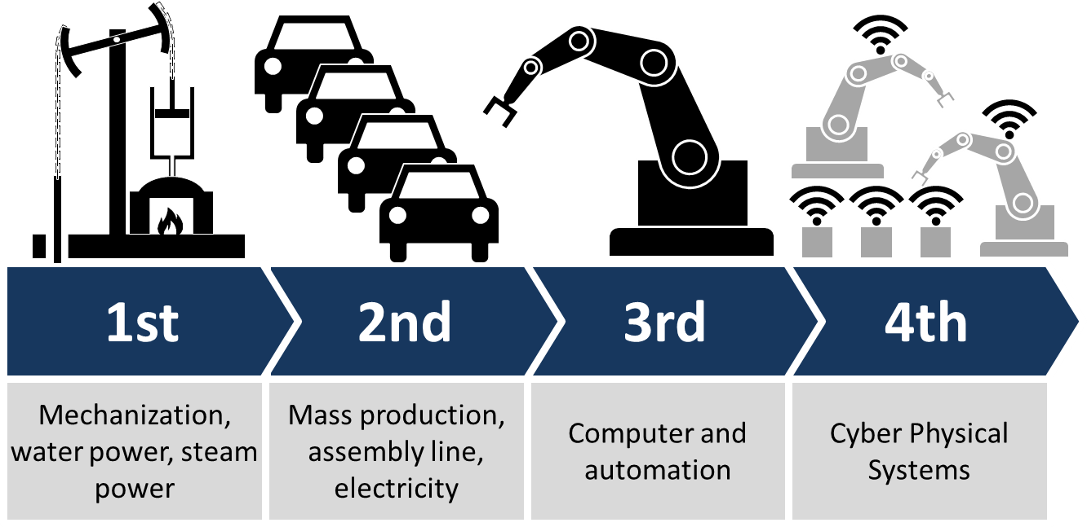
CHANGE AGENT
INDUSTRY 4.0 or SMART FACTORY

Slide 13
CHANGE AGENT
STARTUPS

Slide 14
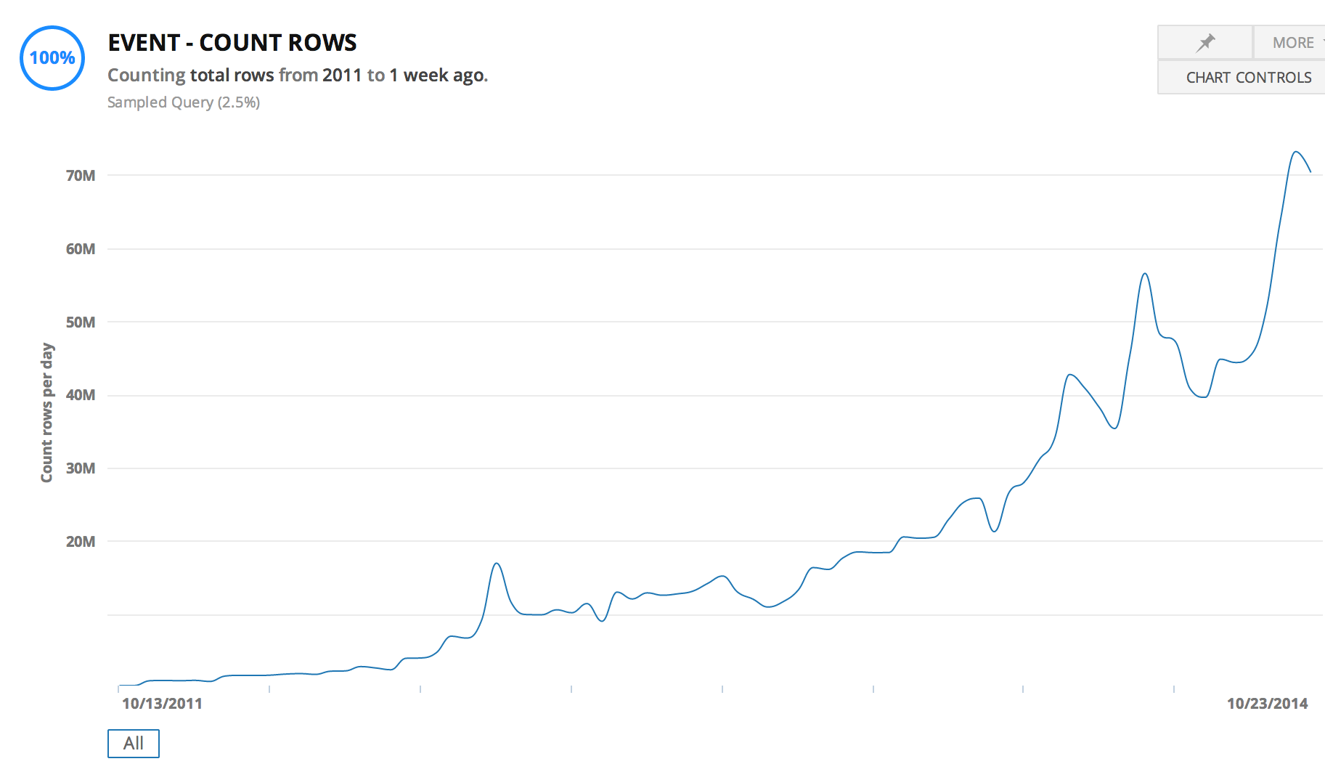
STARTUP DATA SCALE

Slide 15
CHANGE AGENT
1 Gigabyte
$2.64 billion in 1965
$0.09 in 2020 (India)

Slide 16
THE KNIGHTS OF CHANGE
OPEN SOURCE SOFTWARE IS SOFTWARE WITH SOURCE CODE THAT ANYONE CAN
INSPECT,
MODIFY,
OR ENHANCE.

Slide 17
THE CHANGE
Real time + Highly available + Large DATA
In
Economically feasible way
Notes:
Automated cars
Real-time bidding (RTB)
Stock exchange
Telemedicine
Blockchain

Slide 18
THE FIRST IDEA: DISTRIBUTED SYSTEMS

Slide 19
SERVER – CLIENT ARCHITECTURE
CLIENT
CLIENT
CLIENT
SERVER

Slide 20
SCALING
CLIENT
CLIENT
CLIENT
VERTICAL
SCALING
SERVER

Slide 21
DISTRIBUTED SYSTEMS
CLIENT
CLIENT
CLIENT
HORIZONTAL
SCALING
SERVER CLUSTER
NODE 1
NODE 2
NODE 3
NODE 4

Slide 22
HORIZONTAL SCALING - REPLICATION
CLIENT
CLIENT
CLIENT
REPLICATION
SCALE ONLY FOR PERFORMANCE
LOAD BALANCER
SERVER CLUSTER
COMPANY
DATA
COMPANY
DATA
COMPANY
DATA
COMPANY
DATA

Slide 23
HORIZONTAL SCALING - PARTITIONING
CLIENT
CLIENT
CLIENT
PARTITIONING
HAVE TO KNOW WHERE TO GO
UNBALANCED
PROXY
SERVER CLUSTER
COMPANY
EUROPE
DATA
COMPANY
AMERICA
DATA
COMPANY
ASIA
DATA
COMPANY
AFRICA
DATA

Slide 24
HORIZONTAL SCALING - SHARDING
CLIENT
CLIENT
CLIENT
SHARDING
CAN BE SLOW
AGGREGATOR
SERVER CLUSTER
COMPANY
DATA A
COMPANY
DATA B
COMPANY
DATA C
COMPANY
DATA D

Slide 25
BARE METAL SERVER
ISSUES
COSTLY
COMPLICATED
HARD TO SCALE

Slide 26
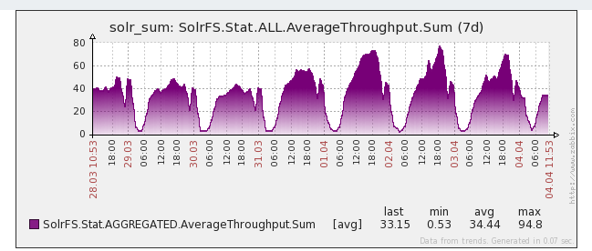
USE CASE – DAY/NIGHT PROBLEM
THROUGHPUT

Slide 27
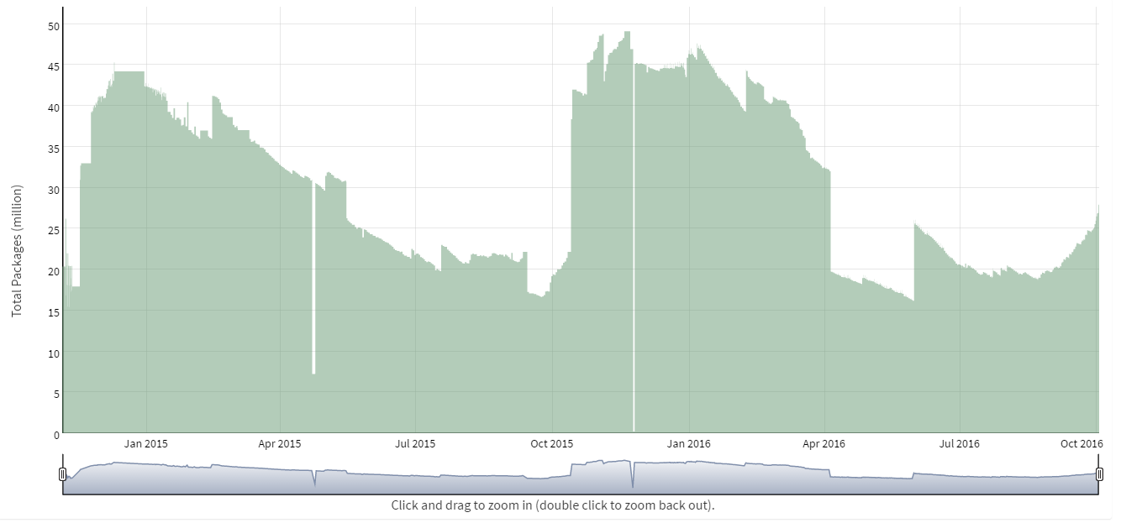
USE CASE – SEASONAL INVENTORY
DATA SIZE

Slide 28
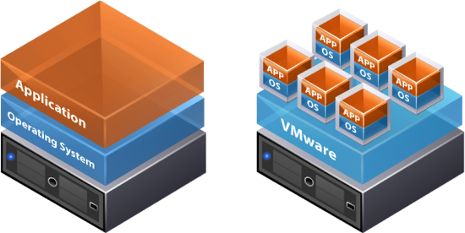
THE NEXT IDEA: VIRTUALIZATION + DATA CENTERS

Slide 29
VIRTUALIZATION
ISSUES
COSTLY
COMPLICATED
HARD TO SCALE
SECURITY: PRIVATE VS PUBLIC

Slide 30
THE NEXT IDEA: CLOUD

Slide 31
USE CASE - AMAZON
…
5% utilized
NODE 1
NODE 2
NODE 3
NODE 4

Slide 32
CLOUD
2006

Slide 33
WHAT IS CLOUD?
A PIECE OF SOFTWARE WHICH OFFERS:
TOOLS TO REMOTELY AND SIMPLY HANDLE
VIRTUAL HARDWARE AND/OR SOFTWARE.

Slide 34
CLOUD
ISSUES
COSTLY
COMPLICATED
HARD TO SCALE
SECURITY
BENEFITS
GEO SAFE
AUTOMATION
IAC (Infrastructure as code)

Slide 35
FURTHER BENEFITS
XAAS
IAAS – Infrastructure as a service
PAAS – Platform as a service
STAAS – Storage as a service
SAAS – Software as a service
DAAS – Database as a services
Serverless

Slide 36
CLOUD PROVIDERS

Slide 37
THE NEXT IDEA: BUILD NEW TOOLS

Slide 38
RDBMS IN A NEW PERSPECTIVE
RDBMS
= DESIGNED FOR OPERATIONS
= DESIGNED TO BE PERFECT IN EVERY SITUATION

Slide 39
CHARACTERISTICS OF RDBMS
Consistency is always guaranteed
Consistency over availability
Fully available or not available at all
…
FOR MORE READ ABOUT: ACID & CAP
Notes:
Consistency: Availability correlates with revenue and consistency generally does not.
Availability: partial availably ?
100% PERFECT
= $$$$$

Slide 40
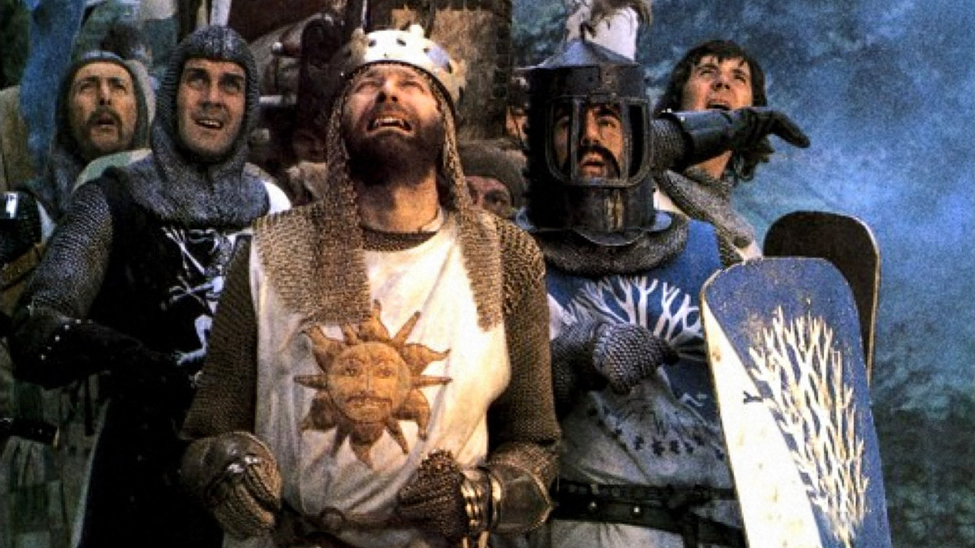
DO WE REALLY NEED RDBMS PERFECTION?

Slide 41
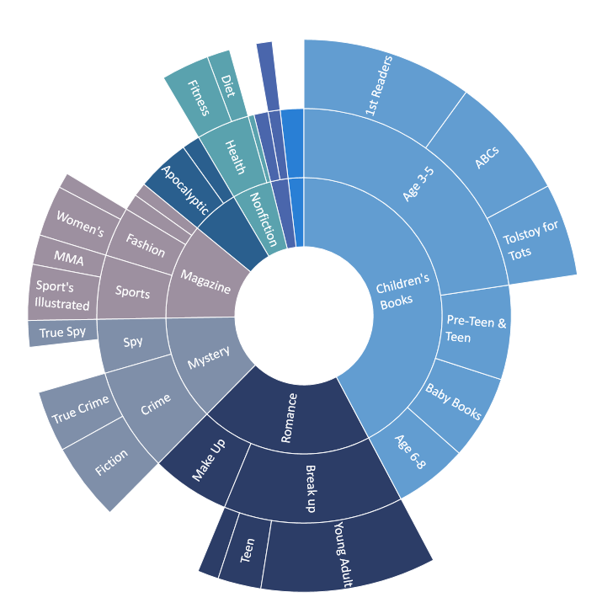
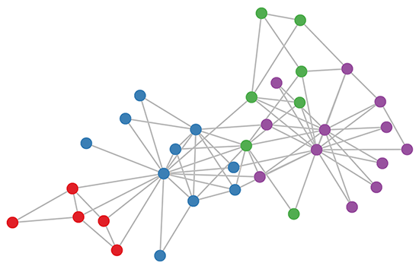
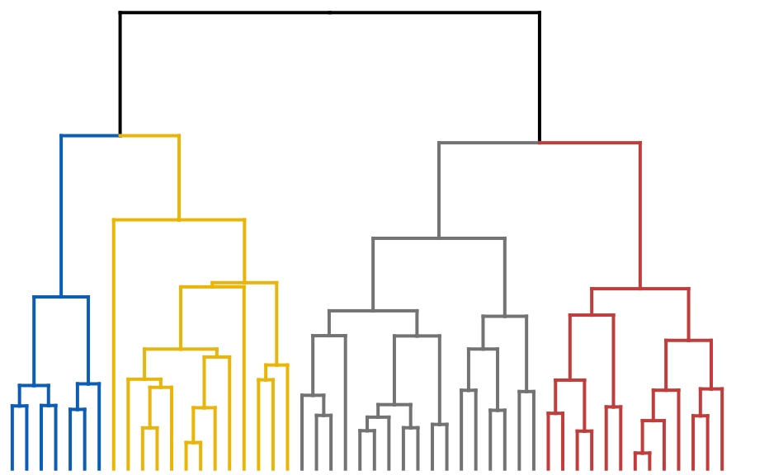
CAN WE GO BEYOND TABULAR DATA?

Slide 42
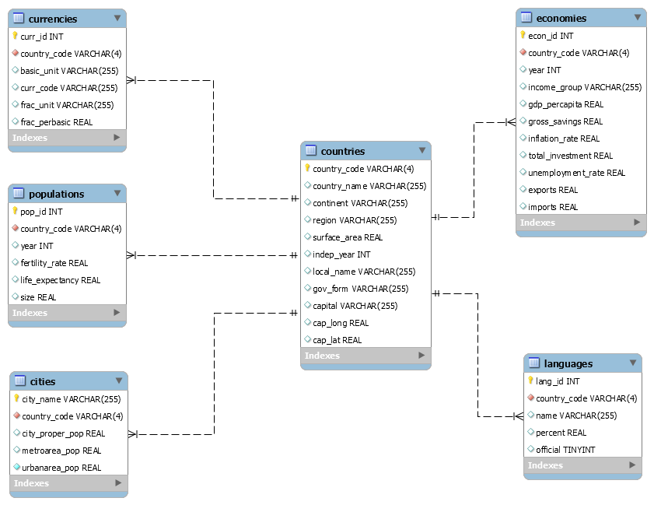
DO WE NEED THOSE RIGID SCHEMAS?

Slide 43
SPECIALIZED
NEW TOOLS
RDBMS

Slide 44
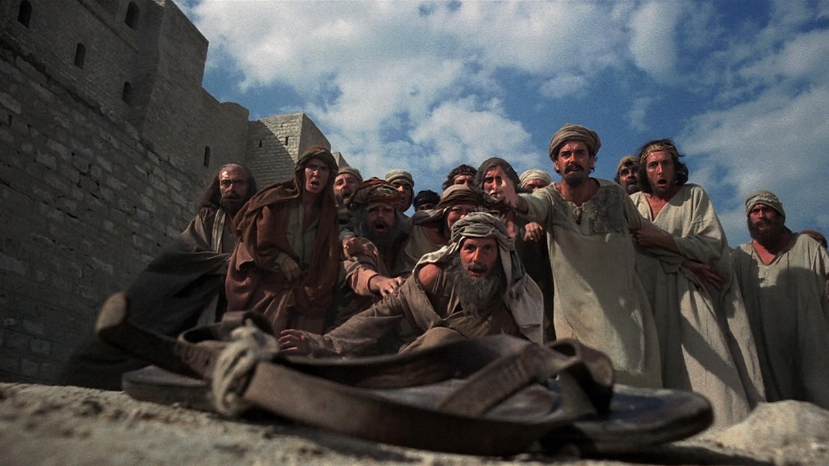
BIG DATA, NOSQL, …

